Slide 1
Water Prism: Decision Support Framework for Water Resource Risk Management
Robert Goldstein Senior Technical Executive, Water & Ecosystems
WSWC–WGA Energy–Water Nexus Workshop Denver, April 2, 2013

Slide 2
Approaches to Reaching Sustainability
Top down
Community/region/watershed-based
Considers all stakeholder demands
Matches aggregate water demands to supply
Bottom up
Sector/Facility-based
Objectives
Increase water use efficiency
Conservation

Slide 3
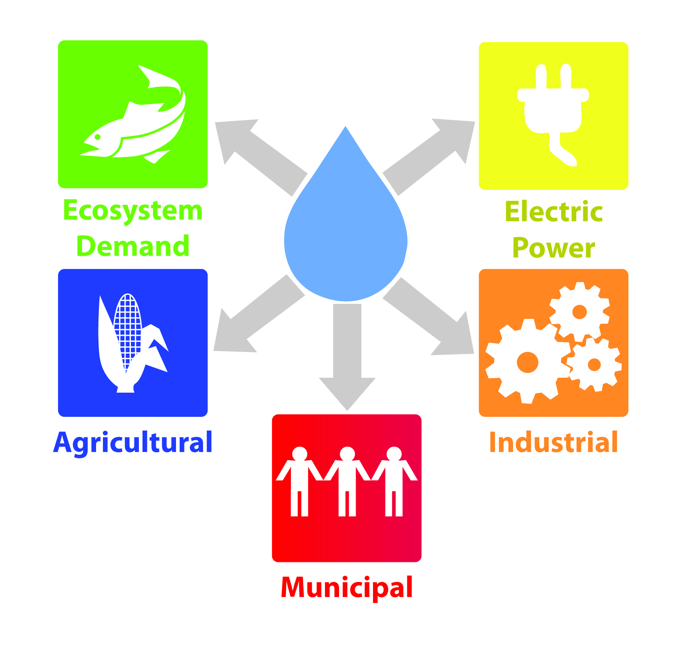
Drivers for Development of Water Prism
Electric power generators reliance on water resources
Manage environmental, regulatory, reputational, and financial risks
Water stewardship disclosure requests
Water saving technologies are emerging for all sectors
A need for tools to evaluate strategies across sectors:
Accommodate future demands within limits of available water
Encourage collaborative water planning
Roadmap for sustainability is difficult to define given system complexities
Evaluate benefits of water resource management strategies and technologies

Slide 4
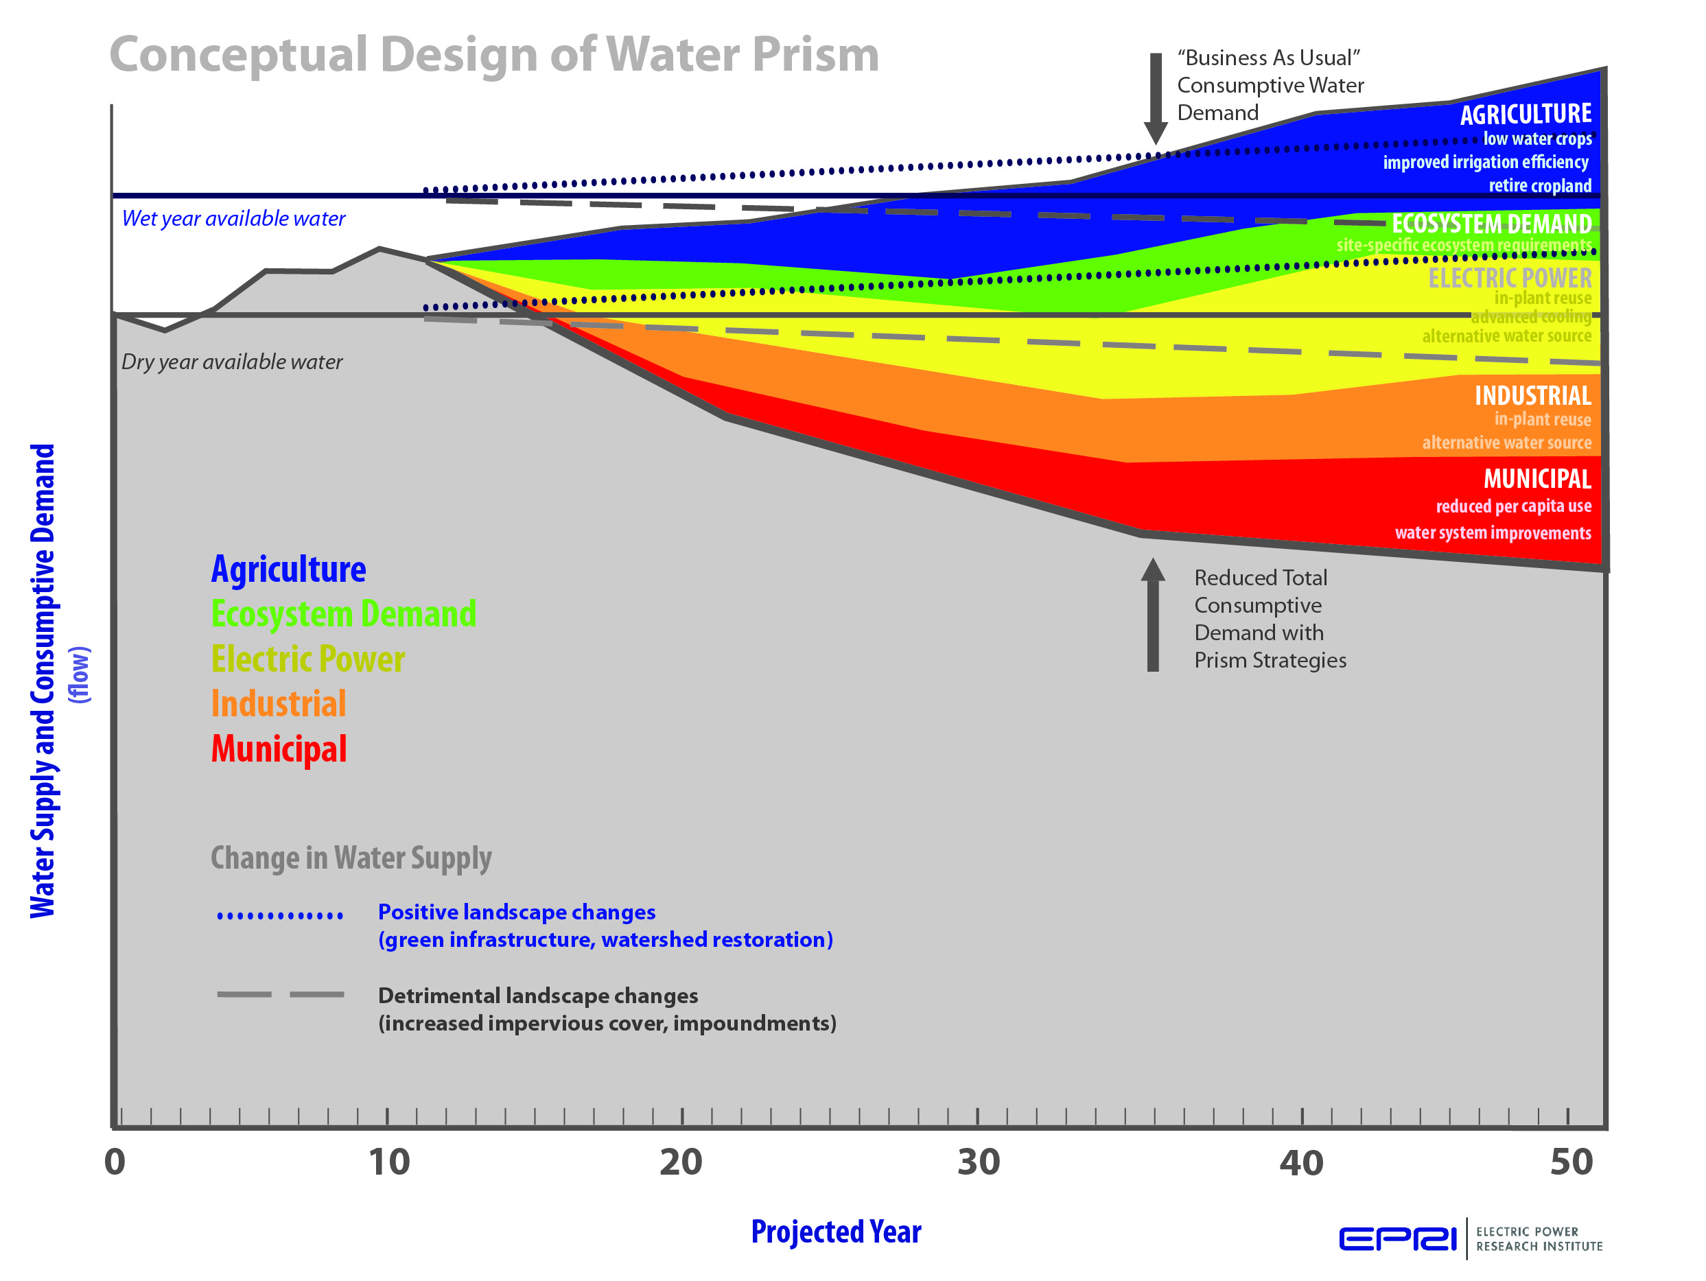
Water Prism Conceptual Design
Compute system water balance on regional scale
Surficial watershed model
Groundwater sources and uses
Project consumptive and withdrawal demands for 40 to 50 year horizon
Explore water saving strategies through scenario analysis
Examine various scenarios to consider water use reductions needed to keep “demand” below “supply”
Water Prism Volume 1: Tool Development (EPRI 1023771)

Slide 5
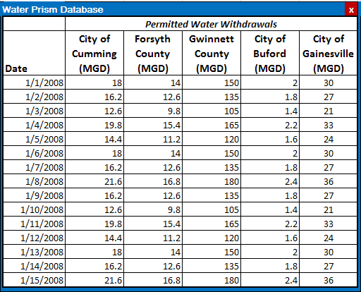
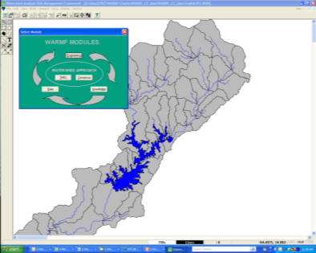
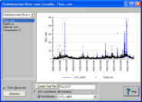
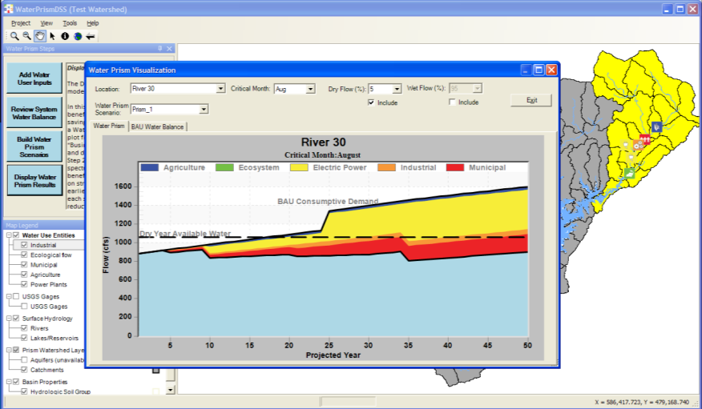
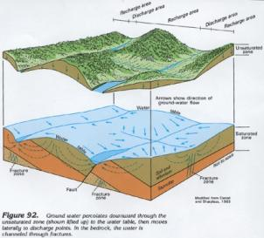
Water Prism Design Overview
Population, Energy Demand, Irrigated Land use
Land use, Climate, Topography, etc.
Water Prism Access Database
Watershed Model
Available Surface Water
Water Prism DSS
Groundwater
Storage
Ground Water Data

Slide 6
Four Basic Steps of a Water Prism Analysis
Define Available Surface Water (calibrate watershed model)
Define Available Groundwater (map and parameterize major aquifers)
Add Water User Inputs
1. Calculate regional water balance
Review System Water Balance
2. Compare projected water demand with available water
Major Water Prism Steps
Build Water Prism Scenarios
3. Generate scenarios with water saving strategies
Display Water Prism Results
4. Display reduced water consumption and/or withdrawal as a Water Prism spectrum

Slide 7
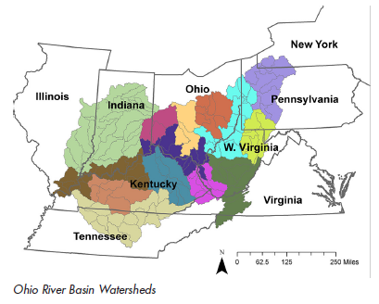
Preliminary Water Prism Applications
2. Green River Watershed
1. Muskingum River Watershed
Goal – demonstrate tool functionality
Leverage watershed modeling from EPRI’s Water Quality Trading Project
Promote synergies between projects

Slide 8
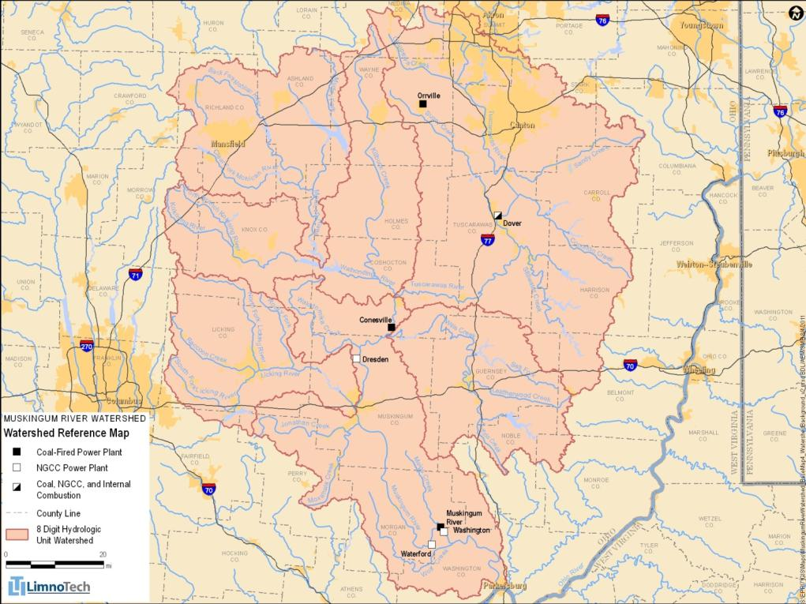
Muskingum Watershed Background
Area: ~8,000 mi²
Spans 5 counties and sections of 22 others
Several cities
Largely agriculture
Water Use:
174 surface water withdrawals
329 groundwater withdrawals
319 point sources
Power Plants:
2 large coal-fired – primarily once-through cooling
2 small coal-fired
3 NGCC (1 going online 2012) closed cycle cooling
Notes:
Akron and Canton are major cities in the NE portion of the watershed. Columbus lies to the west of the shed.

Slide 9
Muskingum River Power Plants
Power Plants in the Muskingum River Basin
Plant | Type | Owner | Capacity (MW) | Cooling Technology | Water Source
Conesville | Coal-fired | AEP | 1745 | once-through(1 unit)/ closed cycle (3 units) | Muskingum River, some groundwater
Muskingum | Coal-fired | AEP | 1425 | once-through (4 units)/ closed cycle (1 unit) | Muskingum River, some groundwater
Waterford | Natural Gas (CC) | AEP | 917 | closed cycle | surface water
Dresden* | Natural Gas (CC) | AEP | 580 | closed cycle | surface water
Washington | Natural Gas (CC) | Duke | 620 | closed cycle | surface water
Dover | Coal-fired, Natural Gas | City of Dover, OH | 36.5 | once-through (1 unit), closed cycle (2 units) | surface water, some groundwater
Orrville | Coal-fired | Orrville Dept. of Public Utilities | 84.5 | closed cycle | wastewater effluent, some municipal and groundwater
* Under construction; expected to go on line in 2012

Slide 10
Input Data Sets for WARMF and Water Prism
Required Data Sets | Watershed Model (WARMF) | Water Prism DSS | Data Source | Time Period | Frequency
Topography (DEM) |  |  | USGS NED | 2009 | 30 meter
Land use / land cover |  |  | NLCD | 2006 | N.A.
Climate |  |  | NCDC | 1990-2009 | Daily
Observed streamflow |  |  | USGS | 1990-2009 | Daily
Groundwater properties (aquifers, recharge) |  |  | USGS | N.A. | N.A.
Ecological flow / reservoir limits |  |  | ? | ? | ?
Water withdrawals |  |  | ODNR | 1990-2009 | Monthly
Water discharges |  |  | OEPA | 1990-2009 | Daily
Projected demands (electric power) |  |  | AEP | Through 2014 | N.A.
Projected demands (other sectors) |  |  | Dziegielewski et. al, 2004 | 2005-2025 | 5-Year
Notes:
NLCD 2006 is the most recent land cover. Water withdrawals were provided in terms of a monthly volume. This was converted to a daily flowrate (constant for each month). Dziegielewski from Southern Illinois University, Department of Geography

Slide 11
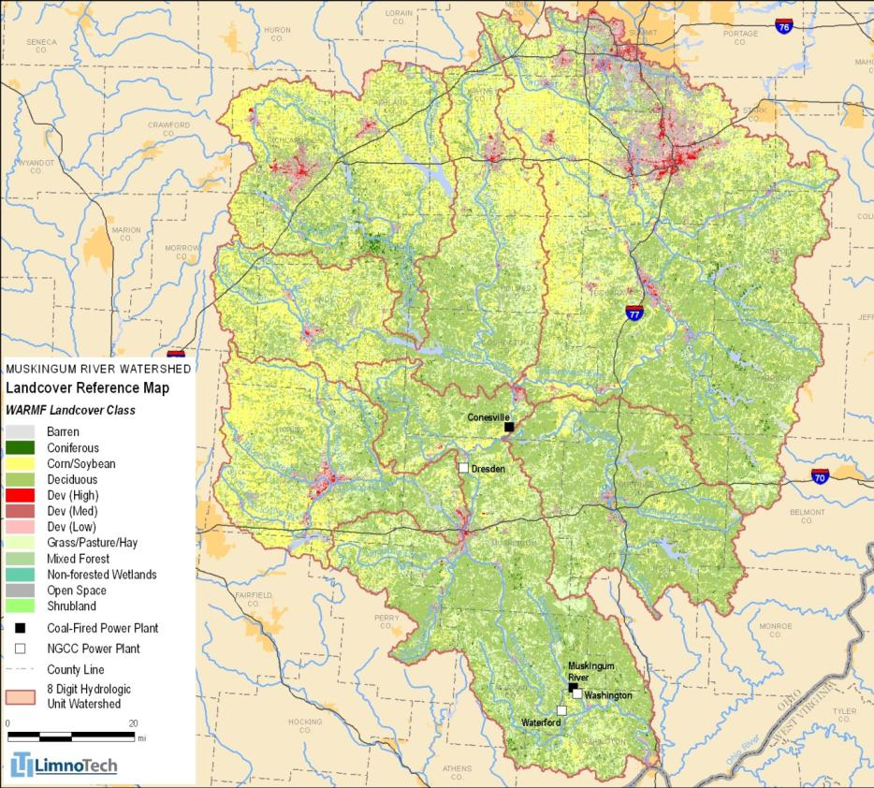
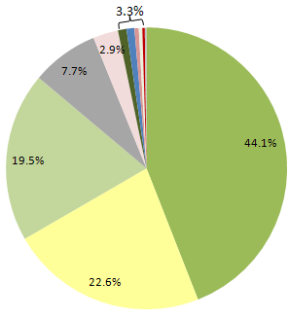
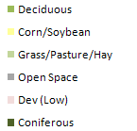
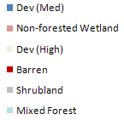
Land Use / Land Cover (2006 NLCD)
Notes:
Mainly rural, deciduous followed by corn/soybean

Slide 12
Principal Aquifers
4 Principal Aquifers
389 to 3741 mi²
Unconsolidated
Shallow, follows river valleys, high porosity, high yield
Bedrock
Deeper, low porosity, low yield
Notes:
Four principal aquifers. Cross-hatched is bedrock, deep, unproductive. Coarse grained near rivers has higher porosity, more productive. A lot of groundwater withdrawals there. Will treat as 4 control volumes, using thickness and porosity to track recharge.

Slide 13
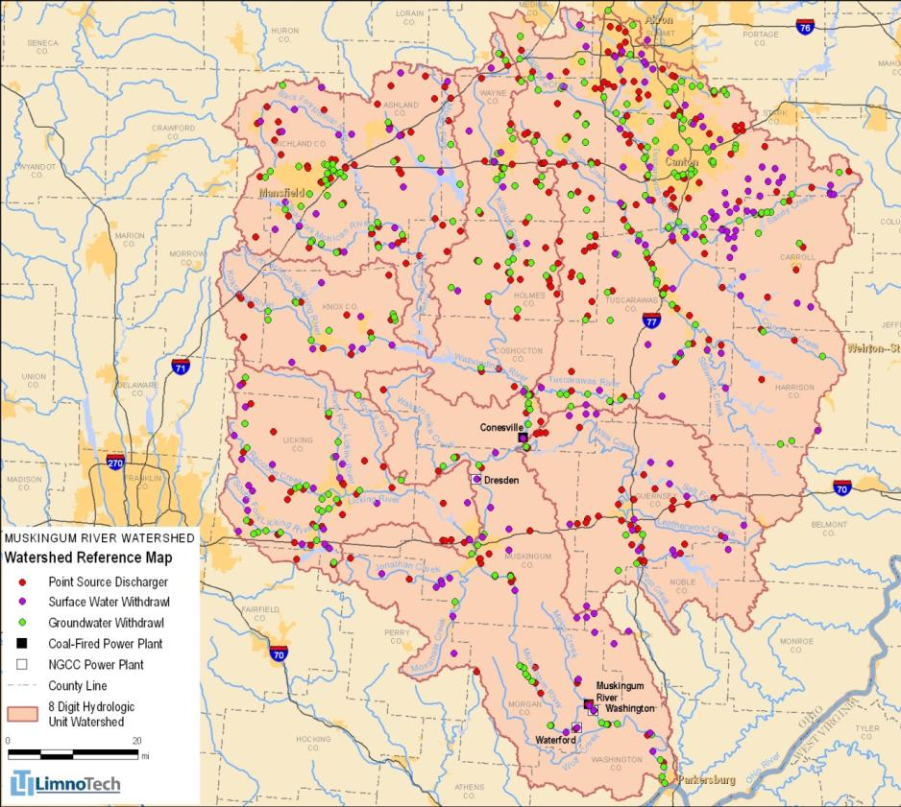
Withdrawals and Returns
Surface water withdrawals
174 facilities
789 MGD (2009)
Groundwater withdrawals
329 facilities
131 MGD (2009)
Point source discharges
319 stations at 307 facilities
915 MGD (2009)
Notes:
789 + 131 = 920 > 915. 5 MGD consumed in 2009

Slide 14
Development of Water Prism Strategies
Planned power plant changes
Retiring once-through coal units
Conversion of coal to natural gas combined-cycle (NGCC)
New NGCC plant on-line
Reduction in municipal and industrial
BAU: State of Ohio projects increased water use due to increased population, increased per capita use and growth in industrial sector
Prism Strategy: Assume decreased per capita use
Reduce withdrawals and returns for municipal and industrial users
8% to 25% reduction over 60 year period

Slide 15
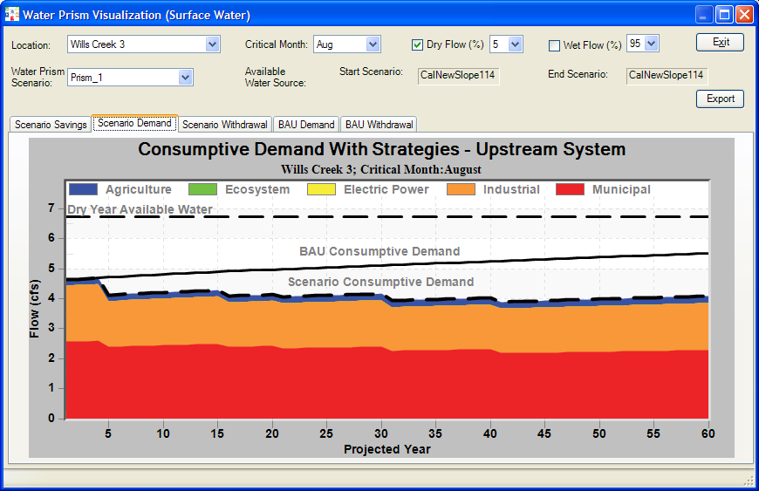
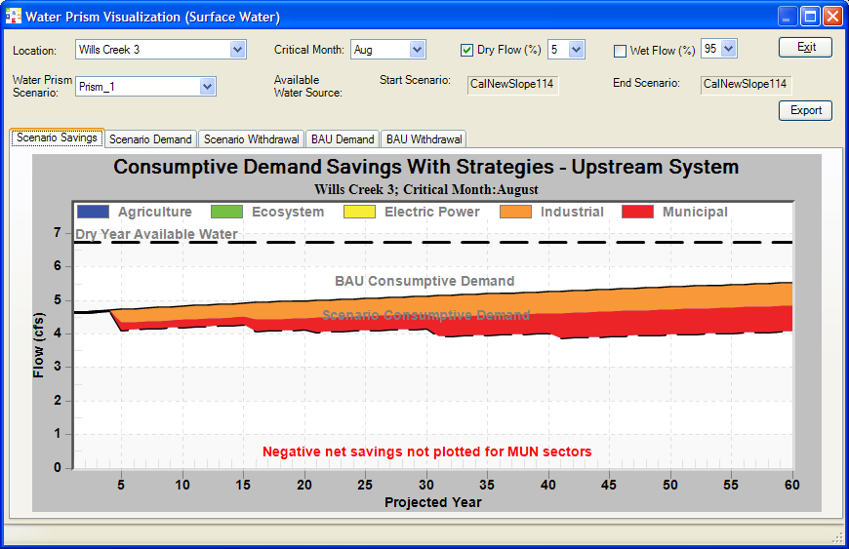
Water Prism Scenario: Reduced Per Capita Use
Surface Water – Small Tributary
Reduced Consumptive Demand for Each Sector
Savings from Each Sector

Slide 16
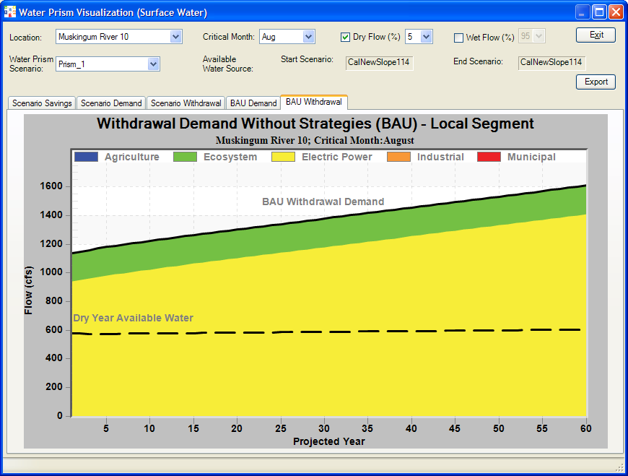
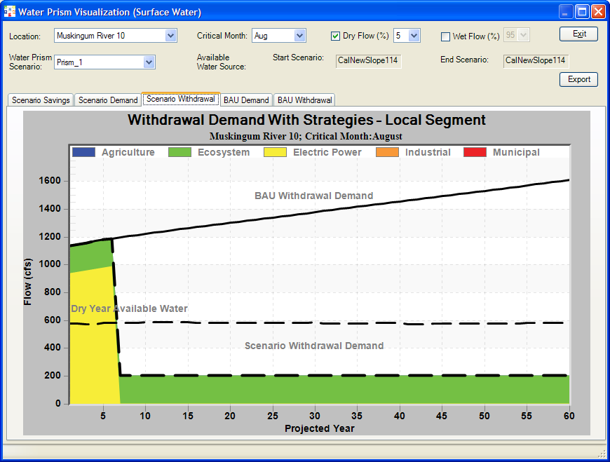
Water Prism Illustrates Impact of Decommissioning and Gas Conversion

Slide 17
Concluding Thoughts
There is no such thing as Business as Usual - everything is evolving with time
Everything is geographically distributed non-uniformly
Top down management is necessary for sustainability
Need localized, fine resolution decision support tool to manage community (watershed, region) water resources
Strategic and technological approaches depend on location
Research can lead to promising breakthrough technologies to save water

