Slide 1
NOAA / WSWC Workshop on Advancing Seasonal Prediction for Water Resources
Jon Gottschalck and Dave DeWitt
NWS / NCEP / Climate Prediction Center
October 21-22, 2015
Salt Lake City, UT

Slide 2
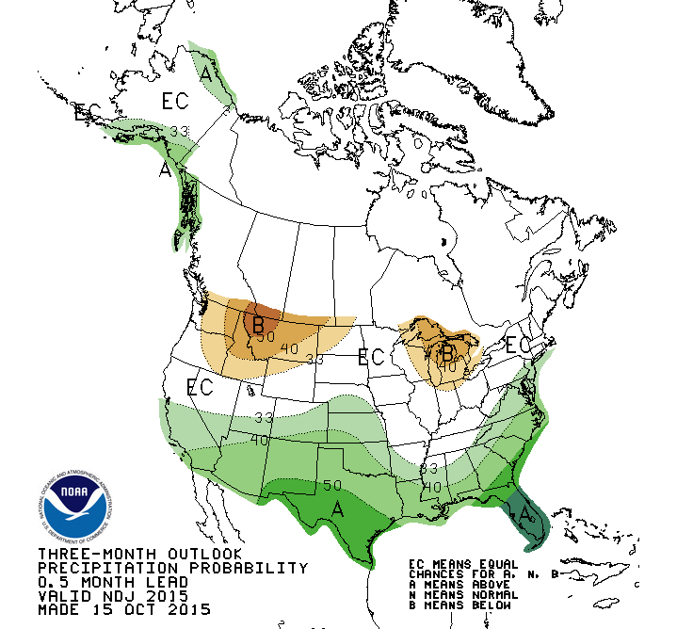
CPC Seasonal Precipitation Outlooks
Released third Thursday of the month
Includes 13, 3-month overlapping seasons
Maps show probabilities of the favored category out of a three class system (B,N,A)
Based on leading climate modes such as ENSO
Statistical and dynamical forecast guidance
Additional value added products available based on forecast maps

Slide 3
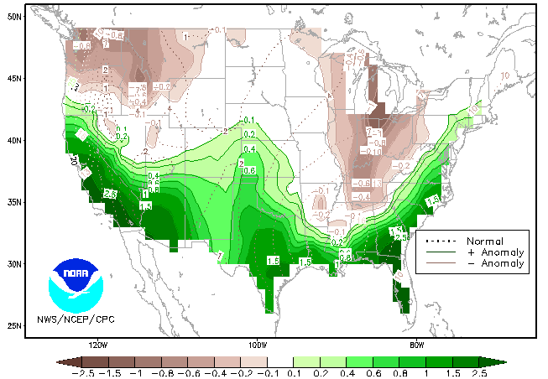
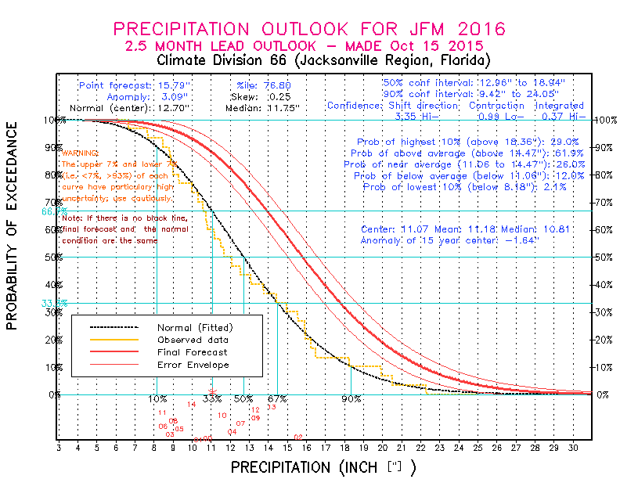
Additional Seasonal Precipitation Information
Northern Florida Climate Division
Probability of Exceedance Graph
Illustrates the shift in the distribution
Anomaly (inches) of the median value of the outlook distribution
Dashed lines are the 1981-2010 median value
Shading are anomalies

Slide 4
Seasonal Precipitation Outlook Skill
Heidke Skill Score
(ranges from -50 ➔ 100)
(top) Spatial map 1995-2015
Sep-Oct-Nov → Mar-Apr-May
(bottom) time series for western CONUS from 2005-2015, all seasons
ENSO events generally responsible for best score periods

Slide 5
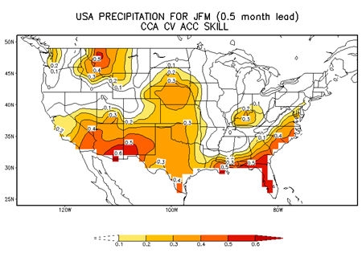
Forecast Tool Support-Historical Skill
Canonical Correlation Analysis
CFS
Constructed
Analogue

Slide 6
Some thoughts
Correctly or incorrectly, less of an emphasis has been placed on developing or improving statistical methodologies in many years
Strong emphasis has and will continue to be placed within NOAA for dynamical model evaluation and development (higher resolution, physics, MME, etc.). This should continue, but this takes time and is expensive.
CPC needs to invest in updating statistical forecast tools: Evaluate the best predictors, regions and use the latest datasets. Unknown how much increase in forecast skill would be gained.
Hybrid approaches need to be developed and accelerated into forecast operations, if deemed helpful. More sophisticated statistical post processing of more reliable dynamical model output (circulation) may bridge gap with eventual observed precipitation.

