Slide 1
NOAA/WSWC Meeting on advancing a Seasonal Precipitation Forecast Improvement Project
Name: Andy Wood
Organization: NCAR Research Applications Laboratory (Boulder, CO)
Email: andywood@ucar.edu

Slide 2
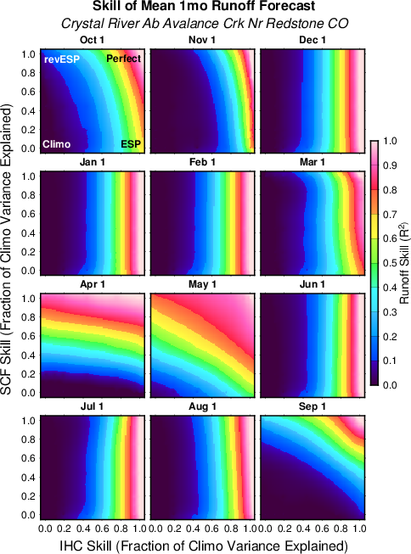
The value of climate forecasts for streamflow prediction depends on
The watershed hydroclimatology
The time of year
What you’re predicting
The quality of your watershed model
One-size-fits-all approaches are likely to be sub-optimal for a particular application
eg, the CPC CCA tool is optimized nationally and cannot possibly be the best in any particular region / basin.
there is a need to involve stakeholders (hydrologists, water managers) early in the project to leverage their local knowledge and datasets

Slide 3
1. What are the knowledge gaps to advance seasonal forecast skill for western watersheds?
There are no current operational calibrated predictions for western watersheds reflecting common user climatologies
we don’t know what the skill of climate products is at watershed scales, given existing products
no established baselines to use as benchmarks for new techniques (I would argue that CPC’s official forecasts are an awkward baseline at best)
Space-time scaling of skill to inform optimal climate forecast use?
we default to model grid or CPC climate zones, weeks/months/seasons
We don’t know the potential for post-processing to improve current practice
eg forecast calibration, multi-modeling, or schemes like CP-based downscaling
We don’t know the potential for region-specific, dynamics-based interpretations of model forecast output to improve raw forecast skill
We don’t go much ‘beyond ENSO’ in our approach to predictions. What about the many regions of the US (and regimes) in which there is little ENSO signal?
Beyond the scope -- but the best avenues for uptake in the user communities are also not well understood.

Slide 4
2. What are the priority research questions that need to be answered to advance seasonal forecast skill for western watersheds?
What other modes of variability / predictability can be harnessed ‘beyond ENSO’ and other usual suspects (PNA, PDO etc), particularly for regions outside with little ENSO signal (like the upper Colorado)?
When/where can region-specific downscaling/calibration, harnessing region-specific dynamics, help?
What are the optimal time-space scales at which to interpret climate model forecasts to support product formation?
How can we best use hindcasting to develop better real-time products?
where do multi-model ensembles fit?
We can’t forecast extremes, but can we develop useful predictions of the potential for certain high-impact extremes?
What level of complexity in post-processing schemes is supportable given the small sample sizes available in seasonal predictions?

Slide 5
3. What are the strengths and weaknesses of the white paper as currently presented?
Strengths
Identifies many of the key areas of potential advancement
Results oriented, with milestones and some thinking about overall process
Balances focus between increases in understanding and new product devel.
Weaknesses
the project scope needs clarification:
scientific understand goal is general, a never-ending challenge, versus water-sector oriented precip forecast improvements given existing or low-hanging new tools (a bounded challenge)
do we stop at precip? temperature is also a critical driver of drought and even flood risk, and do we go from there to snow and streamflow?
what challenges are for broader community to tackle (eg higher resolution models) versus this effort + water stakeholders (eg regional downscaling in the west)
needs greater focus in on regionally specific solutions, particularly related to post-processing (forecast calibration and localization)
could start by more firmly establishing the state of practice (baseline) for watershed-oriented climate prediction
almost no international linkages – what can we learn from…beyond NWS? –
eg, ECMWF S2S project -- http://s2sprediction.net/

Slide 6
Related: A S2S Streamflow Prediction Intercomparison Experiment
International collaboration facilitated by HEPEX (http://www.hepex.org/)
Participants from NCAR (US), CSIRO (AU), ECMWF (UK), SMHI (Sweden) and others
Focus on 10-12 watersheds and follow protocol to assess and learn from different forecasting strategies (stat, dyn, hybrid) used in major centers around the world.
Skill of different water supply forecast approaches for
Inflows to Reclamation Hungry Horse Reservoir (MT)

