Slide 1
Seasonal Climate Forecasting: Background, Current State, and Prospects for Future Improvement
David DeWitt (with contributions from CPC Staff)

Slide 2
Outline
Background on Climate Prediction Center (CPC)
Difference between Weather and Climate Forecasts
Sources of Seasonal Prediction Skill
Generation of Seasonal Forecasts at CPC
CPC Winter Forecast for DJF 2015-2016
Priorities for Improving Seasonal Forecast Skill in Future

Slide 3
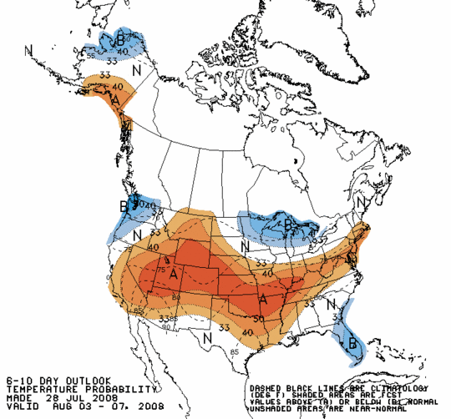
CPC Mission
Deliver real-time products and information that predict and describe climate variations on timescales from weeks to year(s) thereby promoting effective management of climate risk and a climate-resilient society.
Temperature Outlook
Focus: weeks, months, seasons, years (i.e. short term climate)
Integral to NWS Seamless Suite of Products
Valuable resource for NOAA’s efforts to deliver climate services
Notes:
What is the mission of the CPC?

Slide 4
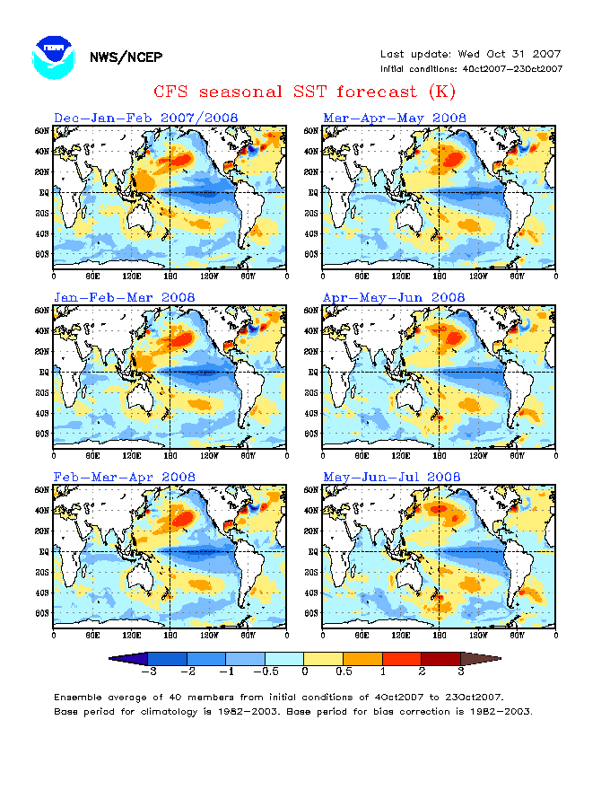
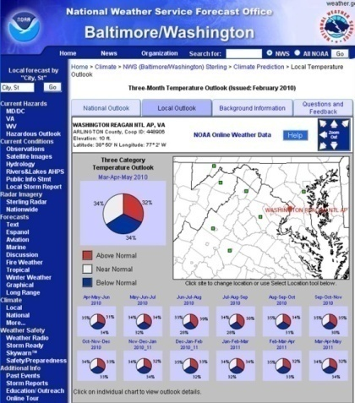
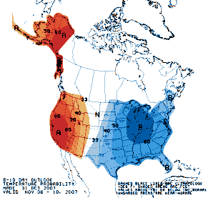
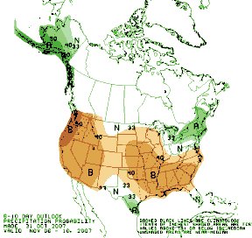
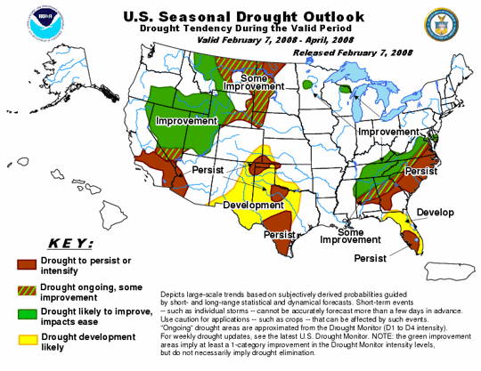
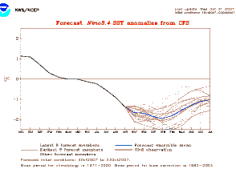
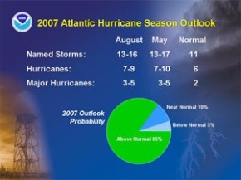
Climate Prediction Products
Focus on week-2 to seasonal-to-interannual
  6-10 Day & 8-14 Day Precipitation & Temperature Outlooks
  Day 3-14 Hazards Outlooks (US, Global Tropics)
  Monthly & Seasonal Precipitation & Temperature Outlooks
  Monthly and Seasonal Drought Outlook
  Seasonal Hurricane Outlooks (Atlantic and Eastern Pacific)
  Monthly ENSO Prediction
Human Forecasters Use Various Tools
To Develop Prediction Products
Dynamical Models
Statistical Models
Historical Analogs
Historical Composites
Notes:
4

Slide 5


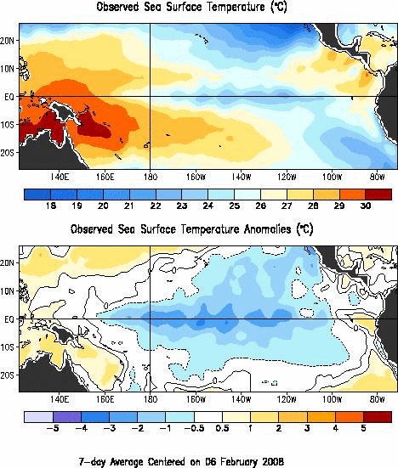
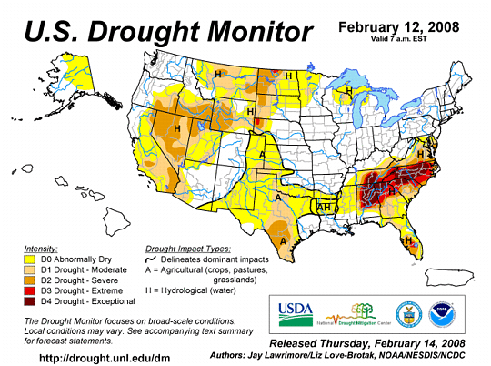
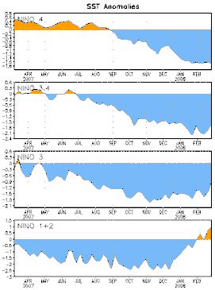
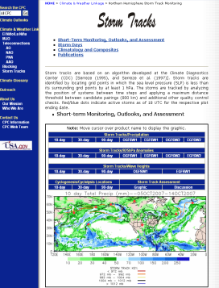
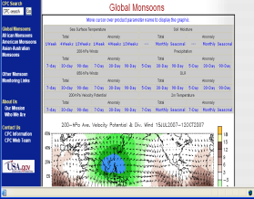
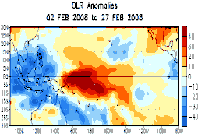
Climate Monitoring Products
Daily and monthly data, time series, and maps for various climate parameters and compilation of data on historical and current atmospheric and oceanic conditions
  Primary modes of climate variability (ENSO, MJO, NAO, PNA, AO,...)
  Atmospheric Circulation (global troposphere and stratosphere)
  Storm Tracks and Blocking
  Monsoons
  Oceanic Conditions (global and coastal)
  Precipitation and Surface Temperature (global and US)
  Drought (US, North America; NIDIS)
  Climate Reanalysis
Notes:
5

Slide 6
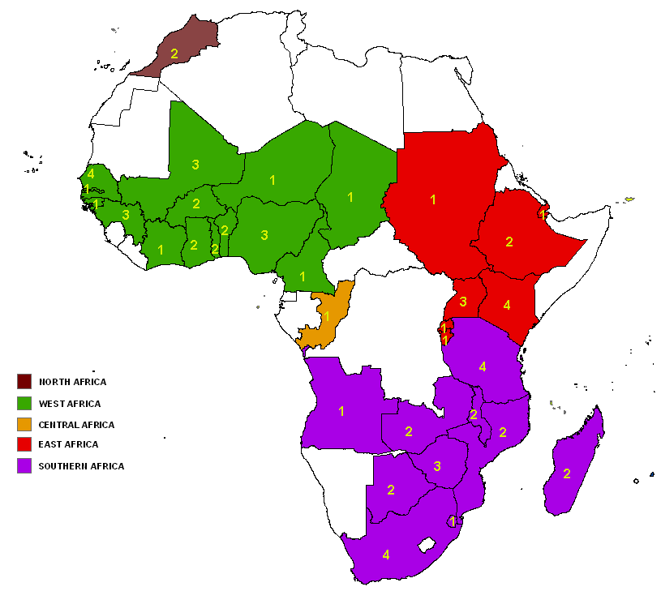
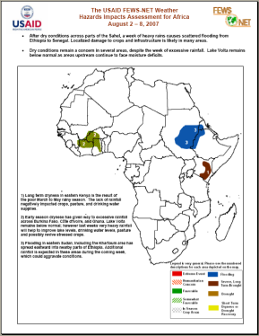
Selected Other Climate Services at CPC
Joint Agriculture Weather Facility
  USDA – DOC partnership
  Weekly Weather and Crop Bulletin
  Briefings & Weather Summaries on global weather and crop conditions
CPC International Desks
  African Desk
  Monsoon Forecaster Training Desk
  Activities
    Training and Education
    Partnerships
    Products Famine Early Warning System Hazards Assessments (Africa, global tropics) Tropical Cyclone Monitoring
Training Coverage in Africa

Slide 7
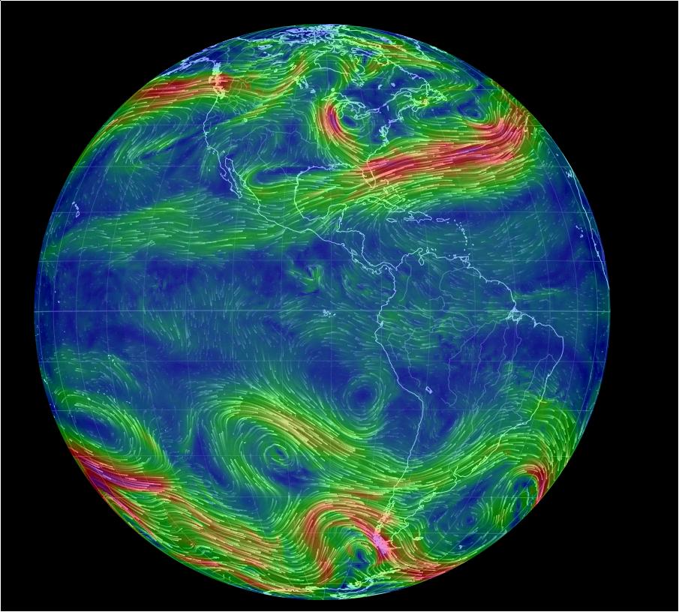
Weather vs. Climate
Weather Prediction
Information often presented “deterministically.”
Example: tomorrow will be 25°C and mostly sunny.
Sensitive to exact initial condition of the atmosphere.
Tracking specific storm systems and fluid motions.
Forecast skill out to 7-10 days.
Hourly Average
500mb Wind anomalies
(30 April 2015)
- from earth.nullschool.net

Slide 8
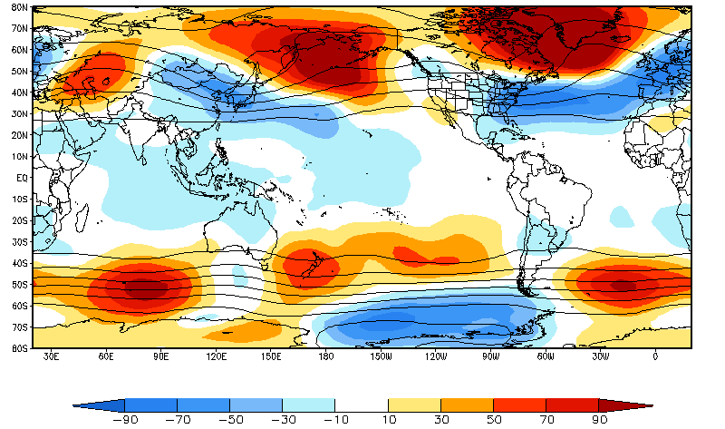
Weather vs. Climate
Climate Prediction
Information often presented “probabilistically.”
Example: Next winter there is a 40% chance of above-average temperatures.
Relies on slower-changing boundary forcing, such as sea surface temperature, soil moisture, sea ice.
Depends on averaging daily data into weekly, monthly, seasonal means.
Forecast skill out to seasons ahead.
Seasonal Average 500mb Geopotential Height
(November 2010- January 2011)
Shading: Anomalies
Contour: Total

Slide 9
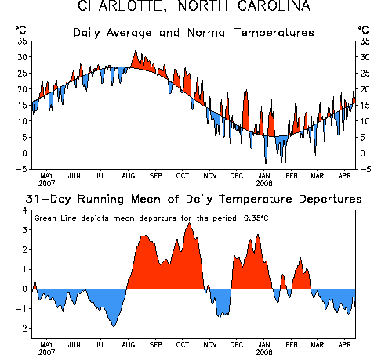
Weather vs. Climate
In climate, we are more interested in predicting the “anomaly” or the part of the variability that is not associated with the seasonal cycle.
Seasonal cycle or Climatology is the smooth black line
“Anomaly” or “Departures” with the seasonal cycle removed (shown are 31-day running means).
Common practice to subtract out 1981-2010 monthly means

Slide 10
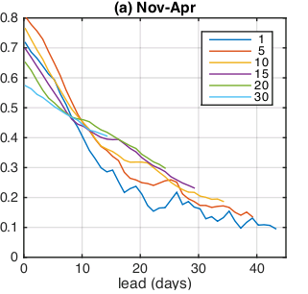
Long-Range Forecast Skill through Averaging
At longer leads, there is generally more skill using 30 day average than using 1 day average.
Length of Time Average (in days)
CFSv2 model prediction of Saudi Arabian rainfall anomalies
Good Skill
Correlation (Spearman’s)
Poor Skill
Figure from Mike Tippett (Tippett et al., 2015 “Extended Range forecasts of areal averaged Saudi Arabia rainfall”)

Slide 11


Where does seasonal predictability over the US come from?
N A T I O N A L O C E A N I C A N D A T M O S P H E R I C A D M I N I S T R A T I O N
Persistent or recurring atmospheric circulation patterns associated with anomalies in
  Initial state of the climate system
  Boundary conditions
    SST (El-Nino/La Nina is dominant signal) but other modes of SST variability also contribute but are less predictable (western Pacific?)
    Soil moisture
    Sea ice
Major modes of variability including MJO, AO, NAO, PNA
Decadal variability or trends
Notes:
+ Please provide a brief overview of current missions, models, products, etc.

Slide 12
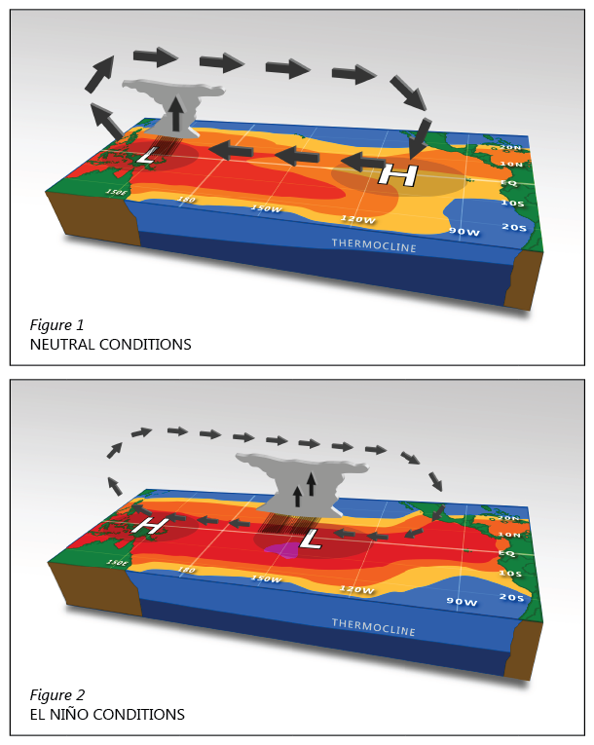
What is the El Niño-Southern Oscillation (ENSO)?
Normal Tropical Pacific (ENSO Neutral)
Irregular cycle (every 2-7 years) of warm (El Niño) or cold (La Niña) conditions in the tropical Pacific Ocean.
Ocean changes occur alongside changes in the tropical atmosphere circulation & rainfall
On average, events last 9-12 months (La Niñas can persist longer) and peak in strength during N. Hemisphere winter
Is a useful predictor because it often forms earlier in the year and peaks in the winter
Warm Tropical Pacific (El Niño)
Accurate prediction of El-Nino is a necessary but not sufficient condition for seasonal prediction of precipitation and temperature over the US

Slide 13
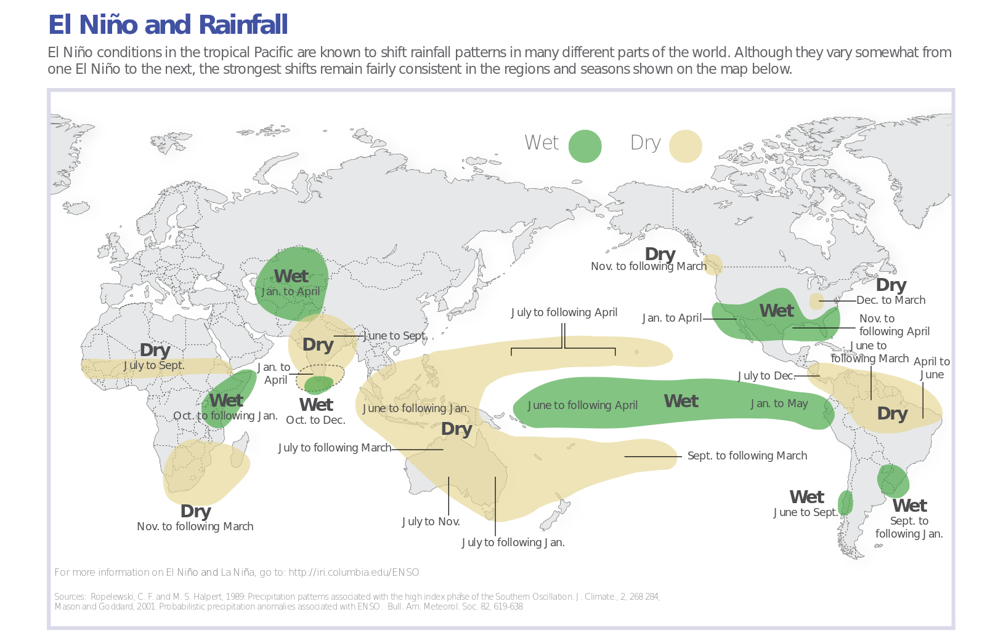
Influence of El Niño on Global Precipitation Anomalies
(while not perfect, the colors can be reversed to indicate the impacts for La Niña)
Map by the IRI/Columbia University

Slide 14
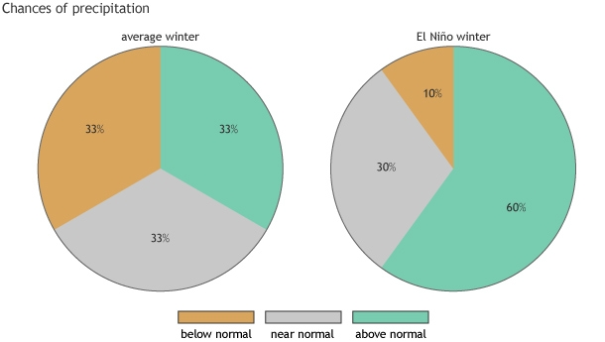
El Niño changes the odds for certain impacts.
The % shift tends to be larger for stronger El Niño events
Idealized Example of Change in Odds of Seasonal Precipitation due to El Nino
… but, impacts are never guaranteed in seasonal climate prediction because there are unpredictable elements that influence the result.

Slide 15
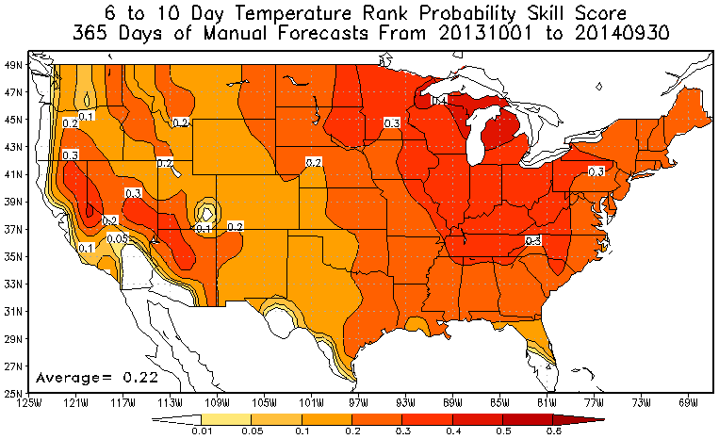
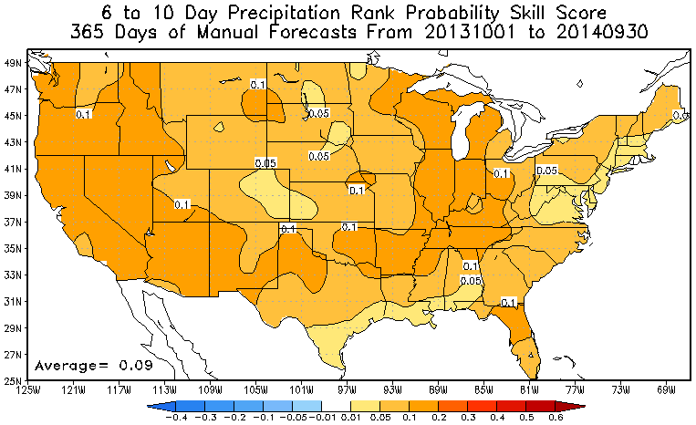
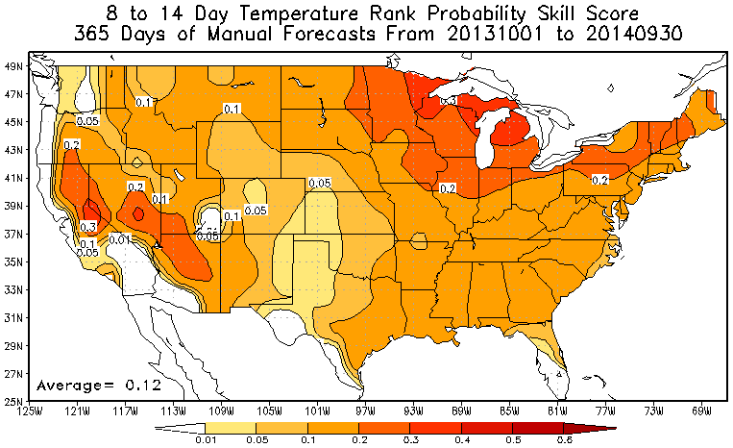
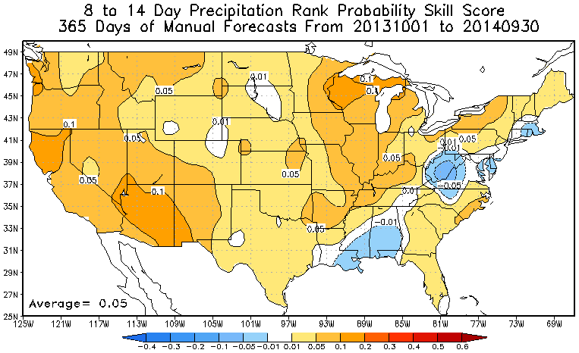
Comparison of Forecast Skill by Field and Lead looks – T/P RPSS
Temperature
Precipitation
Skill Temp > Prec for Same Lead
For Same Field Skill Decreases with Lead

Slide 16
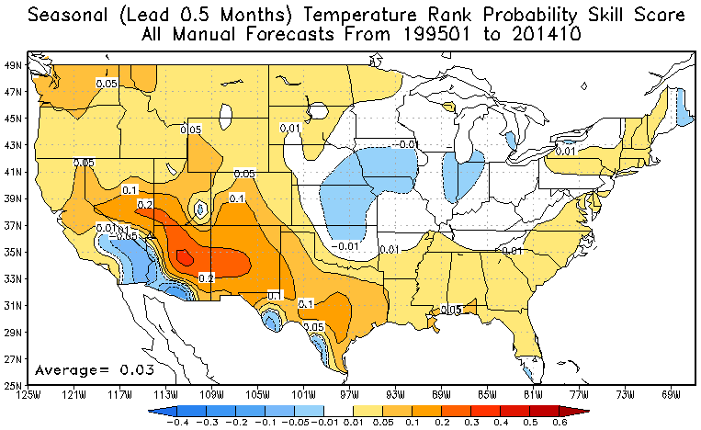
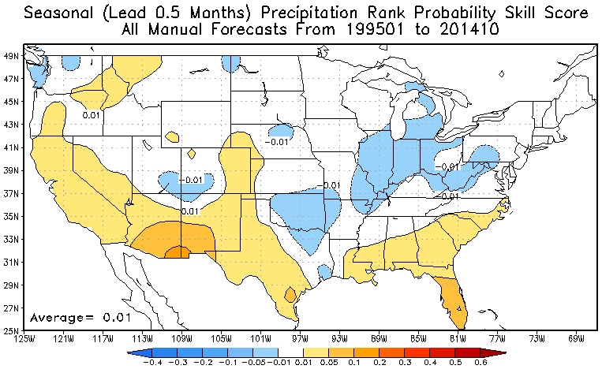
Seasonal Forecast Skill (1995 to 2014) All Seasons
First Lead
Temperature
Precipitation

Slide 17
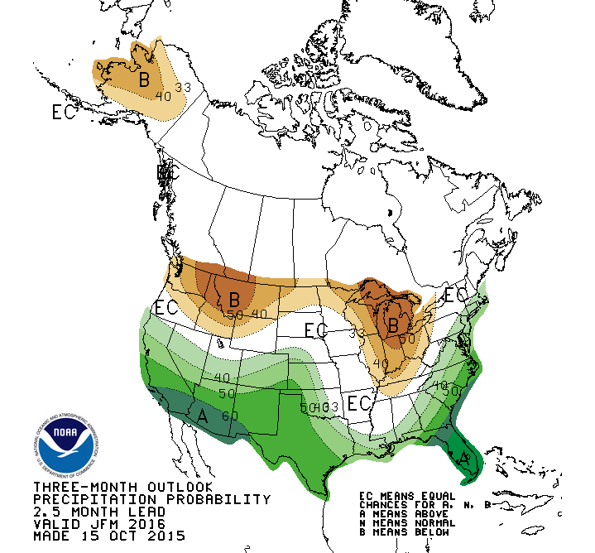
Generation of Seasonal Forecasts at CPC
Human Forecasters Use Various Tools To Develop Seasonal Predictions:
  Dynamical Models
  Statistical Models
  Historical Analogs
  Historical Composites
Goal is to leverage complementary skill
between the tools.
Ultimately, skill of seasonal forecast depends on skill of tools made available to the forecaster.
Notes:
17

Slide 18
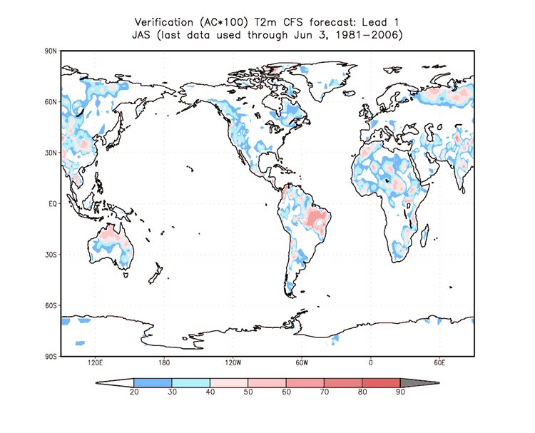
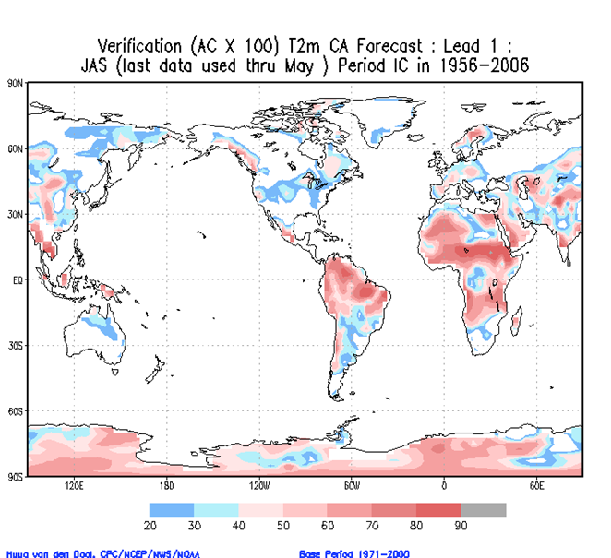
ACC (1982-2010) of Lead 1 T2M Forecast for JAS from CFS and CA
CFS
CA
Statistical and Dynamical Models Can Have Complementary Regions of Skill

Slide 19
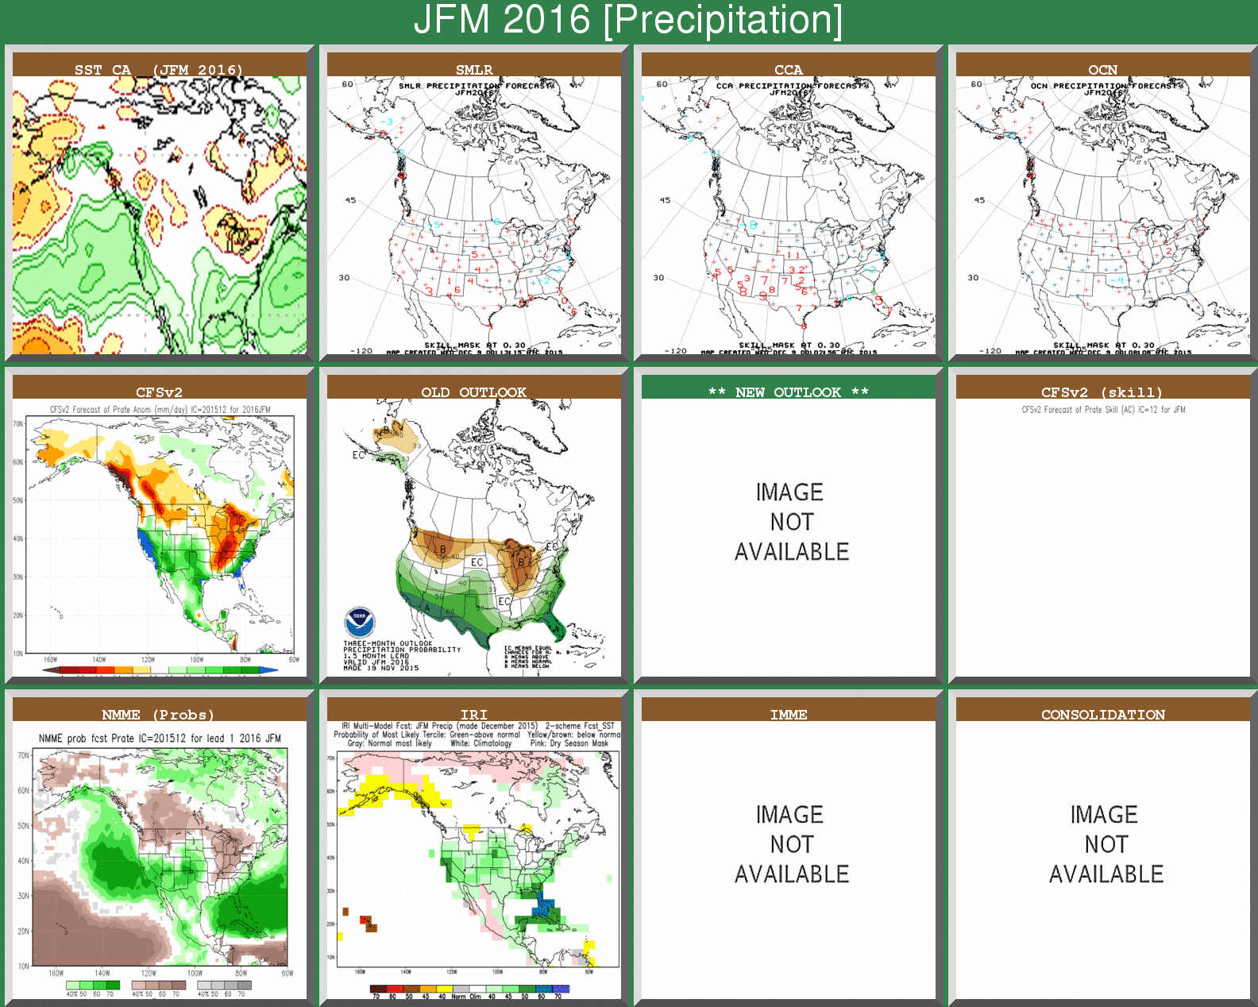
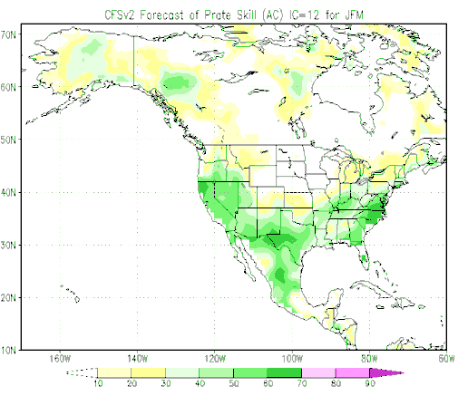

Slide 20
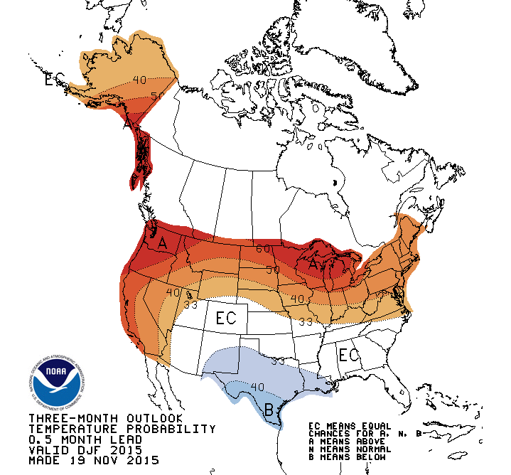

December 2015 – February 2016
Temperature Outlook
N. New York
Below: 22%
Near: 33%
Above: 45%
E. Montana
Below: 16%
Near: 33%
Above: 51%
S. Texas
Below: 42%
Near: 33%
Above: 25%
C. Tennessee
Below: 33%
Near: 33%
Above: 33%

Slide 21
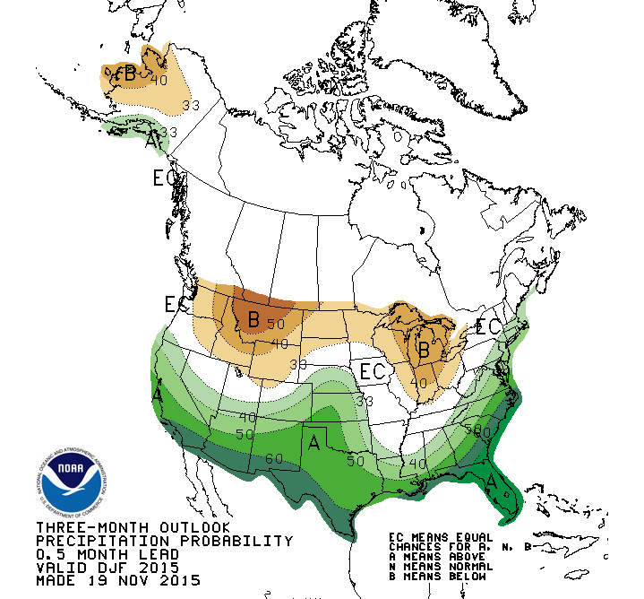
December 2015 – February 2016
Precipitation Outlook
N. New York
Below: 33%
Near: 33%
Above: 33%
W. Montana
Below: 55%
Near: 33%
Above: 12%
S. California
Below: 5%
Near: 33%
Above: 62%
C. Florida
Below: 3%
Near: 23%
Above: 74%

Slide 22
National Academy Assessment of State of Interaseasonal to Interannual Climate Prediction and Predictability (2010)
Main Conclusions for Improving Short-Term Climate Forecasts:
There are no “silver bullets;” there is no single action that will lead to a revolutionary leap forward in ISI predictions.
Incremental increases in ISI forecasting quality are to be expected as the building blocks of ISI forecasts are improved and we increase knowledge of sources of predictability.

Slide 23
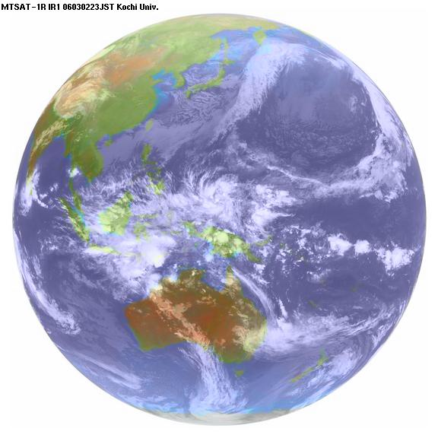
Challenge 1:
Understanding Processes Controlling Organization of Tropical Convection
A pervasive weakness of weather and climate models.
Studies suggest that beyond 10 days, variations in tropical heating are a (the) major source of predictability, including weather events.
Tropical climate biases often appear very early in model integrations.

Slide 24
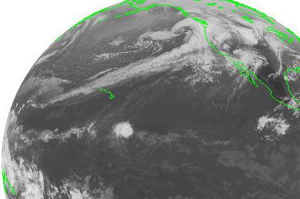
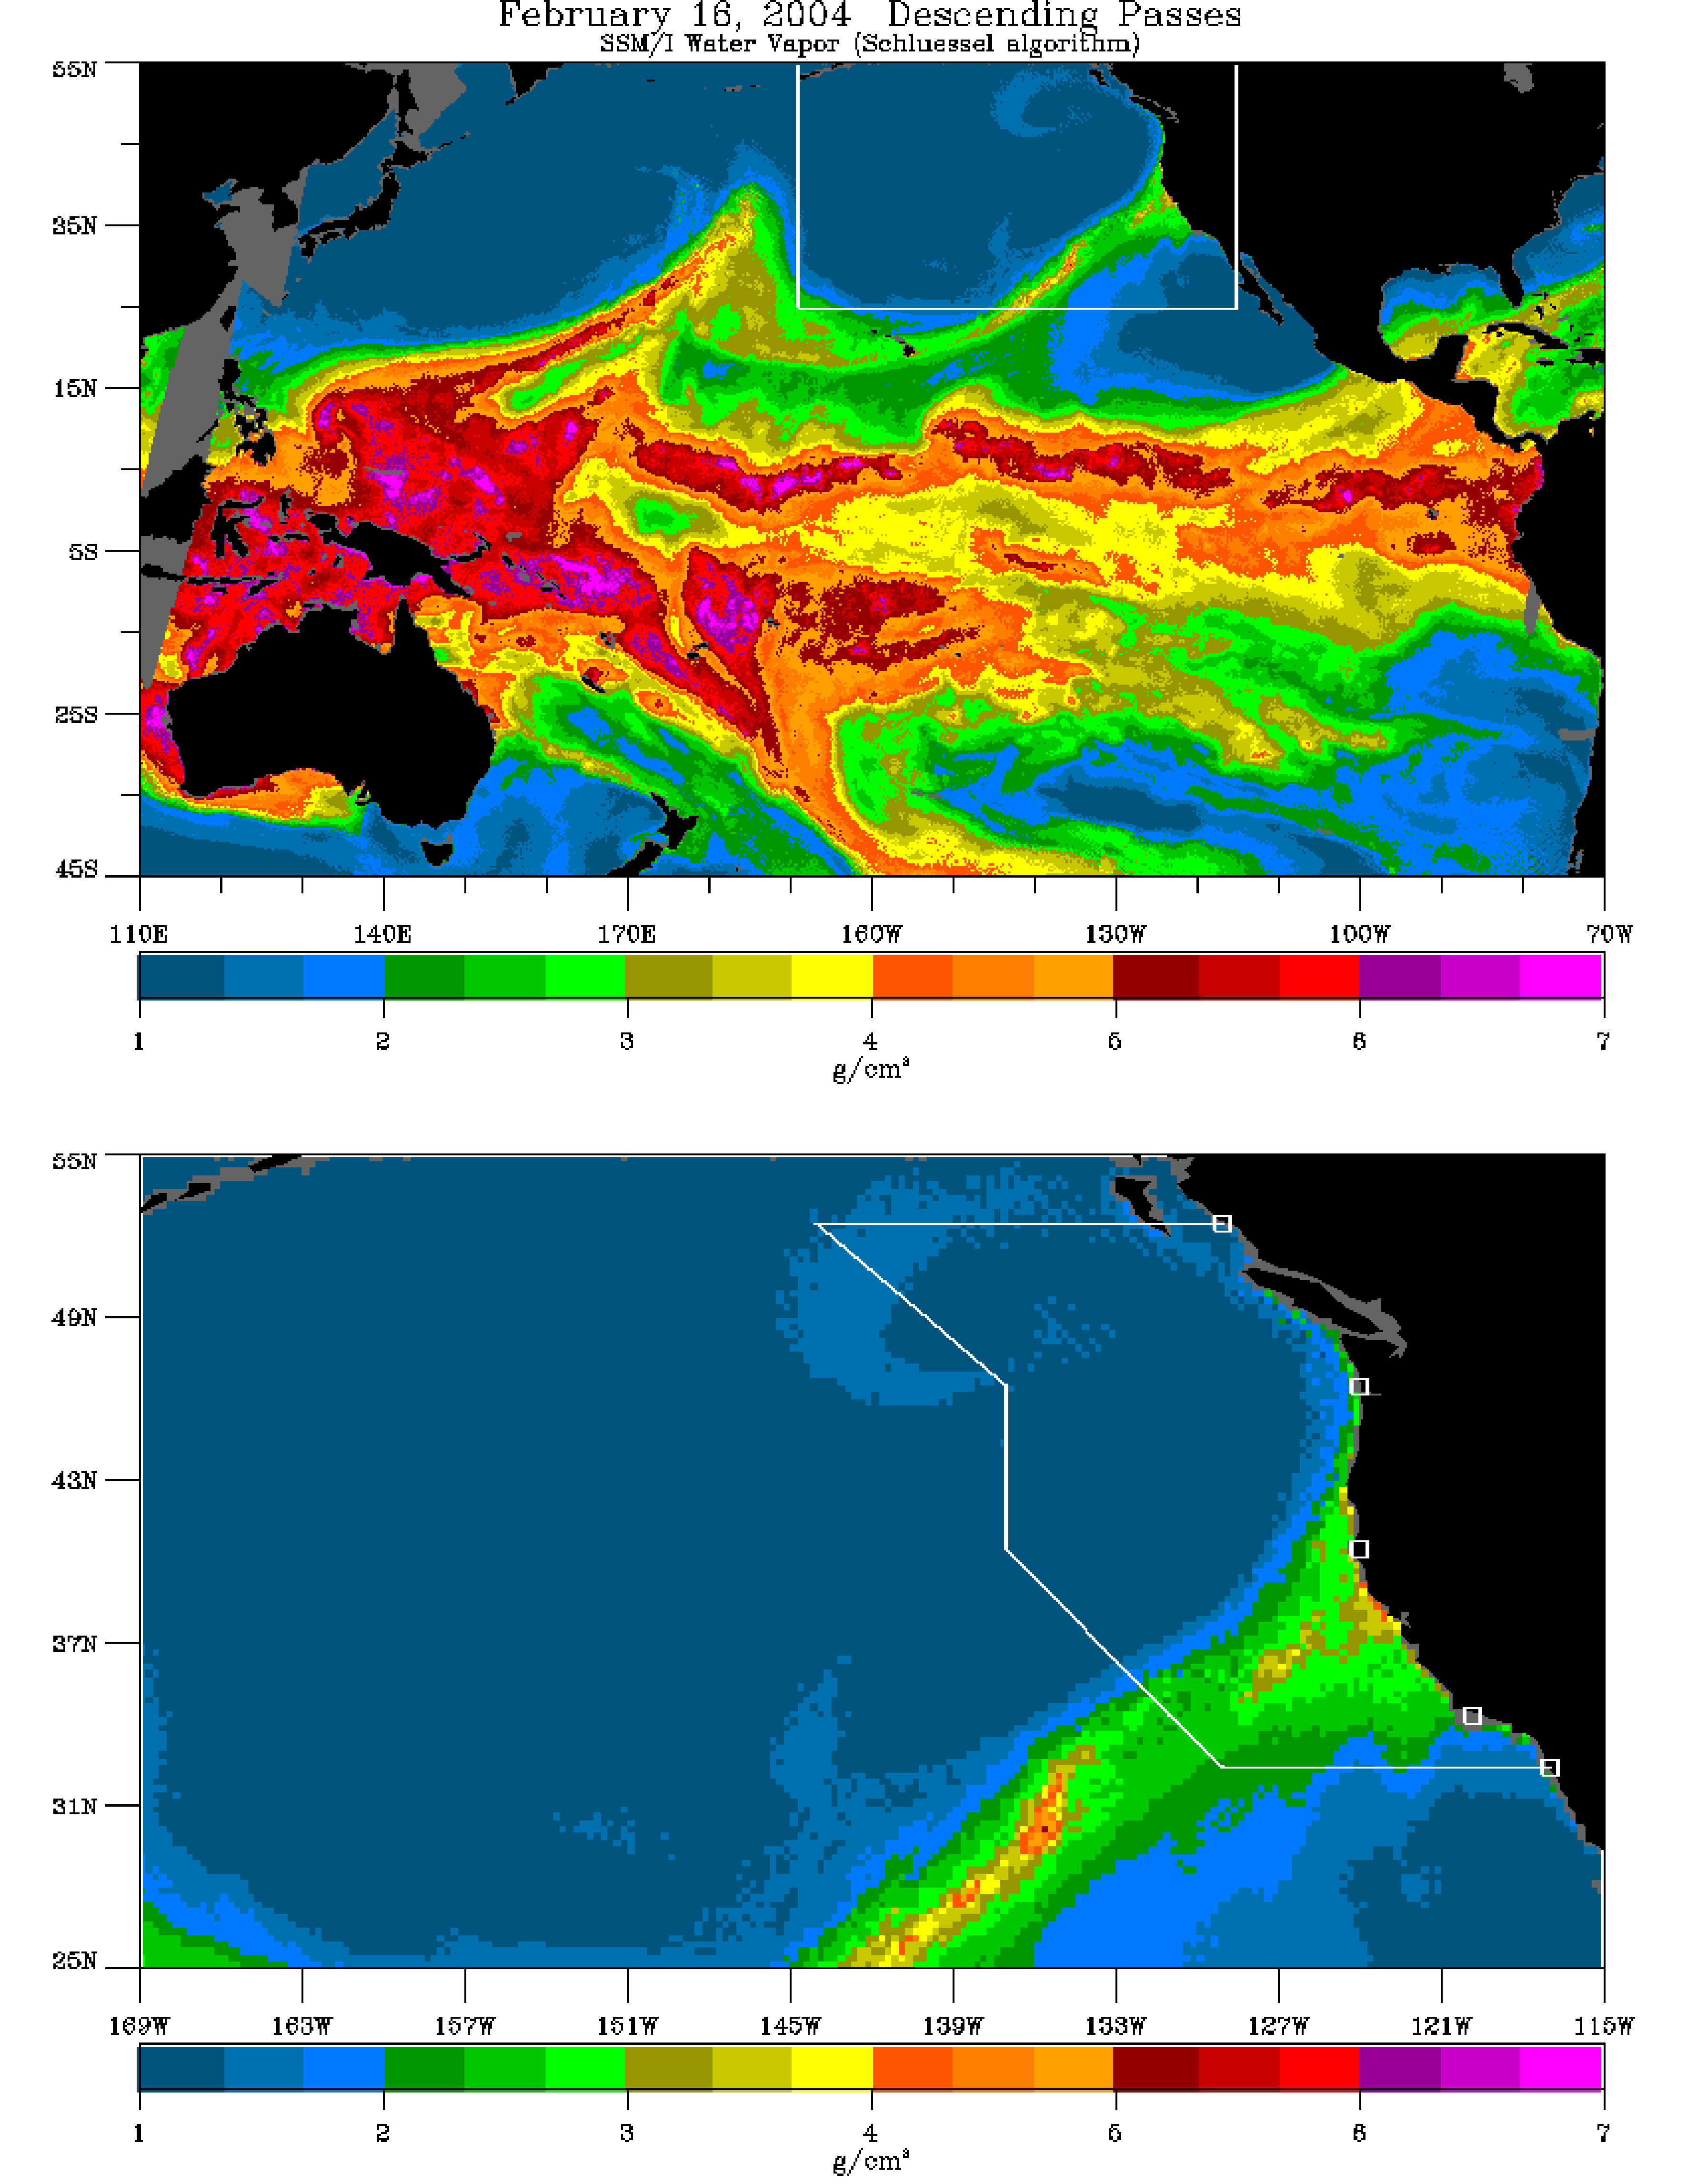
Challenge 2:
Improve Understanding and Prediction
Tropical – Extratropical Interactions
Improve understanding and prediction of:
Madden-Julian Oscillation
“Atmospheric Rivers”
“Pineapple Express” events
Blocking and Storm Tracks
Impacts: West Coast floods
California floods & “Atmospheric Rivers” (Bao et al 06)

Slide 25
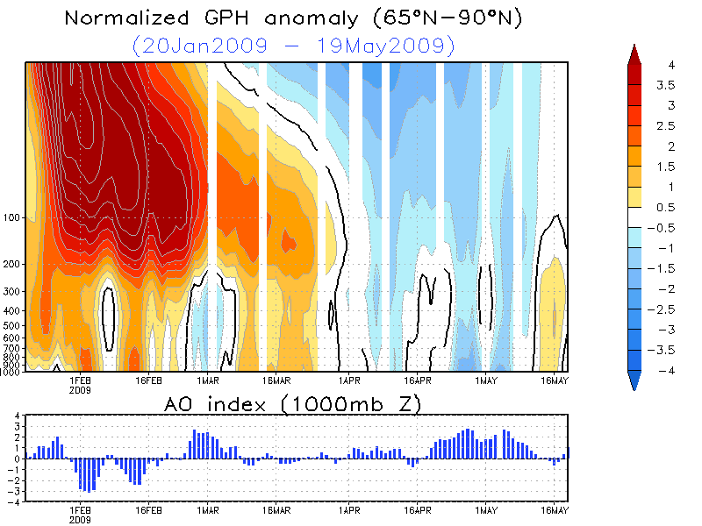
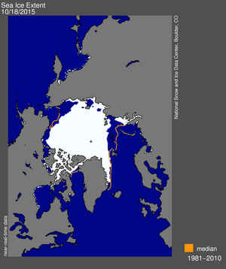
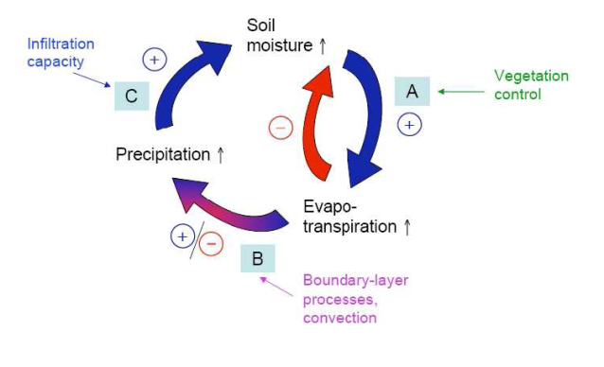
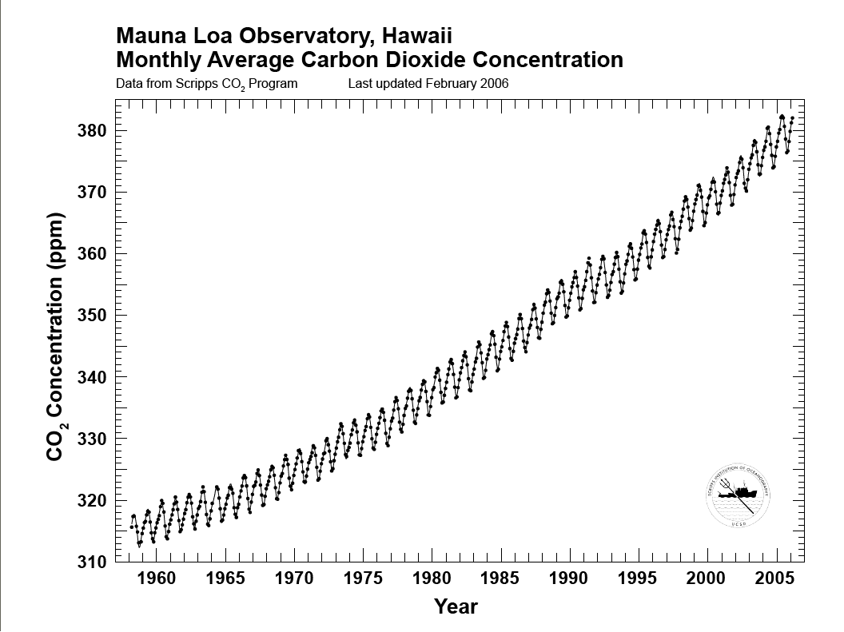
Challenge 3:
Increase Understanding and Exploit Sources of Predictability
Sudden Warming
Key sources that link
climate to weather:
Stratosphere – Troposphere Interactions
Arctic Sea ice
Ocean-Atmosphere Interactions;
Role of sea-surface temperature
Land -Atmosphere Interactions;
Role of soil moisture & land processes
Long-term Trends and
Climate Variability
THE NATIONAL ACADEMIES:
http://www.nap.edu/catalog/12878.html

Slide 26

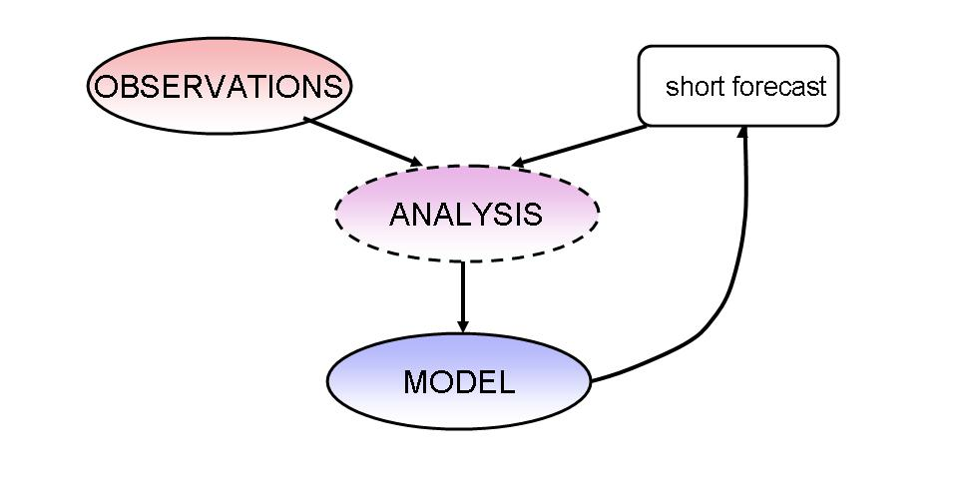
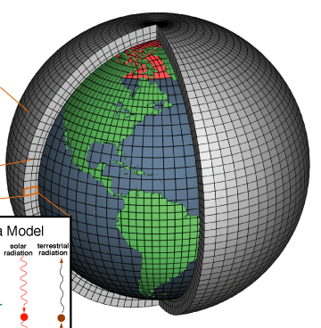
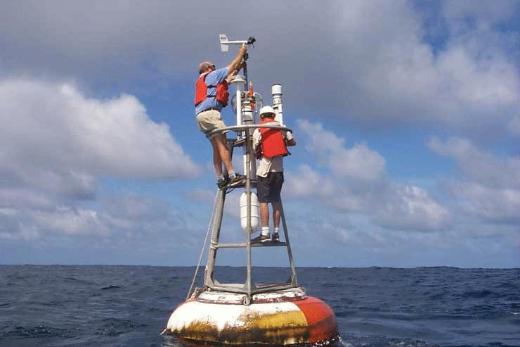
Challenge 4:
Improve the “Building Blocks”
Upgrade Data Assimilation Systems
Identify / correct model errors
Enhance Observational Networks
Improvements in models, observational networks, and data assimilation systems lead to improved understanding and more realistic prediction over time.
THE NATIONAL ACADEMIES:
http://www.nap.edu/catalog/12878.html

Slide 27
Priorities for Improving Seasonal Forecast Skill: Understanding and Modeling Sources of Seasonal Predictability
Madden-Julian Oscillation
Stratosphere-Troposphere Interactions
Ocean-atmosphere coupling (including ENSO)
North Atlantic Oscillation (NAO)/Arctic Oscillation (AO)
Land-atmosphere feedback
Polar Sea-Ice
Atmospheric Rivers
Pacific Decadal Oscillation
Role of SST forcing versus internal variability?

Slide 28
Priorities for Improving Seasonal Forecast Skill: Improved Seasonal Prediction Tools
Identify cause reduce systematic errors in coupled atmosphere-ocean general circulation models (CGCMS):
  Double intertropical convergence zone
  Excessively strong equatorial cold tongue
  Weak or incoherent intraseasonal variability and associated teleconnection
  Failure to represent multi-scale organization of tropical convection
  Poorly represented cloud processes, especially low-level clouds
Increase model resolution to better resolve physical processes and orographic variations

Slide 29
Priorities for Improving Seasonal Forecast Skill: Improved Seasonal Prediction Tools
Improved Representation of physical process in CGCMS:
  Deep and shallow convection
  Planetary boundary layer in the atmosphere and the ocean
  Sea ice
  Soil moisture
  Snow cover
Exploration of new statistical techniques and hybrid dynamical-statistical techniques (ensemble post-processing)
  Need to ensure rigorous cross-validation to estimate true forecast skill

