Slide 1
Improving Sub-Seasonal to Seasonal Prediction at NOAA
Dr. Louis W. Uccellini
Director, National Weather Service
NOAA Assistant Administrator for Weather Services
July 13, 2016 – Congressional Briefing

Slide 2
Value of Weekly to Seasonal Predictions
Emergency Management Planning
Enhance support for longer-term emergency response (e.g., drought)
Increase resilience to weather extremes )e.g. floods, heat waves/fires, cold snaps, severe storms, storm surge, inundation, beach erosion)
Health
Reduce heat-related deaths
Develop heath vector prediction capability
National infrastructure
Improve water resource management and energy sector decision making
Inform agriculture/fisheries and ecosystem planning
National Security
Strengthen national security posture
Enhance awareness, forecast capabilities, and response to environmentally triggered crises (“environmental stress instability”)
Better inform support for humanitarian relief missions worldwide (save money positioning assets)
Notes:
Which area of requirements is most crucial depends on what happened recently or what is in the forecast

Slide 3
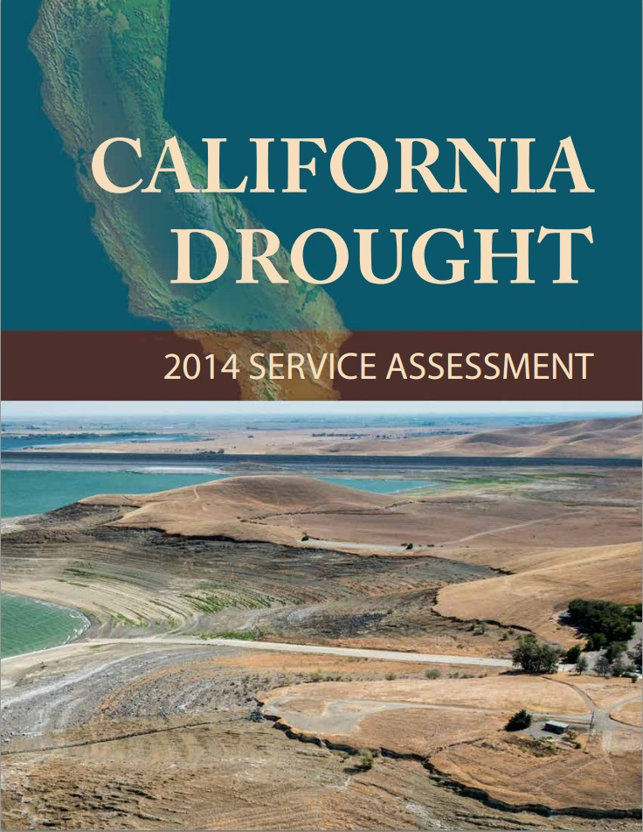
NOAA’s California Drought Service Assessment
Goals:
Understand drought impacted decisions
Assess NOAA’s effectiveness in supporting those decisions
Methodology:
3 focus sectors (water resources, agriculture, fisheries)
100+ interviews
40+ reviewers
400+ comments
Major Recommendations:
Improve seasonal prediction for water resources
Develop full natural flow modeling and forecasting
Improve NOAA internal coordination

Slide 4
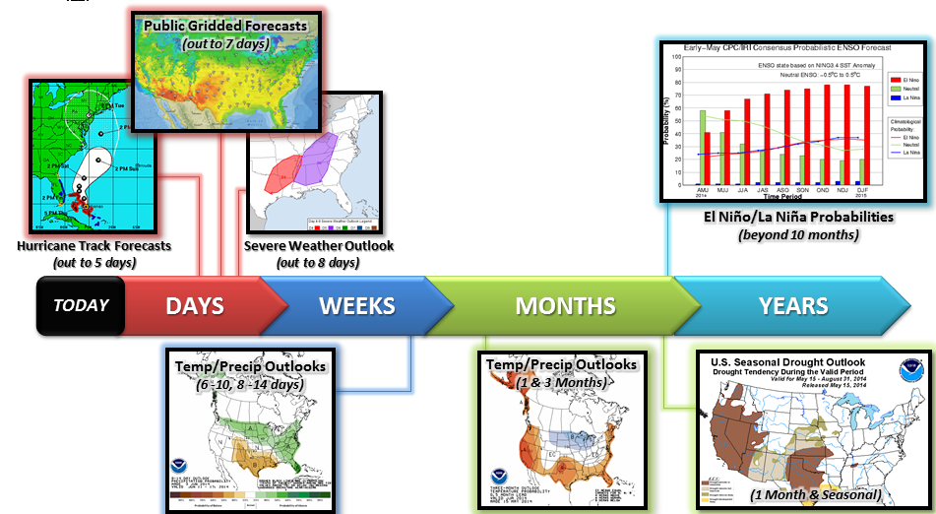
NOAA’s Operational Products
Notes:
Which area of requirements is most crucial depends on what happened recently or what is in the forecast

Slide 5
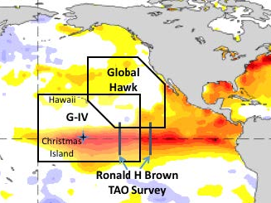
NOAA El Niño Rapid Response Field Campaign
The 2015-2016 El Niño created an unprecedented opportunity to accelerate advances in understanding and predictions of a major extreme climate event and its impacts.
The campaign examined the response of the atmosphere to the warm ocean water at the heart of the very strong El Niño.
Field Campaign Observations: sonde data were assimilated into NOAA’s operational analyses and forecasts and will:
improve understanding of the chain of events leading to extreme weather
be used by NOAA Research to guide weather forecast model development
The campaign demonstrated cross-line collaboration and was a pinnacle in Operations-to-Research supporting basic research.
SST Daily Anomalies
Notes:
Which area of requirements is most crucial depends on what happened recently or what is in the forecast

Slide 6
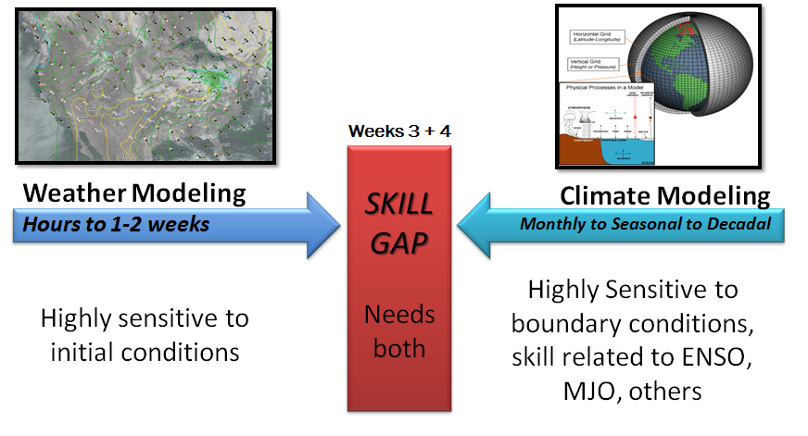
“The Grand Challenge”
Shapiro el at (BAMS, 2010)
Notes:
Which area of requirements is most crucial depends on what happened recently or what is in the forecast

Slide 7
Recent Reviews by: Hoskins (2013), Shukla & Kinter (2006), and BAMS “Grand Challenge” papers (2010)
Description of Current Predictability
0-24 hours | Dynamically predictable, uncertainty in rainfall predictions
1 day – 1 week | Quite predictable, dynamically driven, external forcing & ensembles reduce uncertainty
1 week – 1 month | Less predictable, predictability is episodic in nature, external forcing & ensembles are essential
1 month – Seasons | Predictability contingent on ENSO, MJO, ensembles essential; *BIG RESEARCH AREA* to identify additional sources of predictability
1 year – 10 years | *BIG RESEARCH AREA* Possible predictability related to external forcing
10 years – 100 years | Predictability entirely related to external forcing, especially greenhouse gases
Initialization
Boundary Forcing
Notes:
Which area of requirements is most crucial depends on what happened recently or what is in the forecast

Slide 8
Recent NOAA Initiatives to Address Grand Challenge
Initiative focuses on prediction on the weeks 3+4 time scale
NOAA Initiative (FY16-FY20):
NWS $5M/yr appropriation to enhance operational capability
OAR $4M companion research initiative (not supported in FY16, in President’s Budget FY17)
NWS proposed activities include extending ensemble to 30 days, developing experimental service products (temp/precip, heat, sea ice, tropical cyclones and severe weather outlooks) and competitive grants for predictability research (co-funding with OAR)
Notes:
Which area of requirements is most crucial depends on what happened recently or what is in the forecast

Slide 9
NOAA Progress Toward Improving Sub-Seasonal to Seasonal Predictions
Completed
Operationalized the experimental National Multi-Model Ensemble (NMME), calibrated for predicting extreme events 1-2 months in advance
Initiated in FY16
Extend current ensemble weather forecast system from a 16 day forecast to a 30 day forecast
In Progress
Improve atmosphere, ocean, land, cryosphere coupling for earth system models
Linking ensemble based probabilistic forecasts to stakeholder decisions
Notes:
Which area of requirements is most crucial depends on what happened recently or what is in the forecast

Slide 10
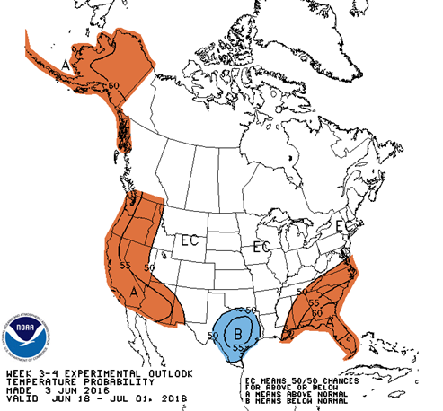
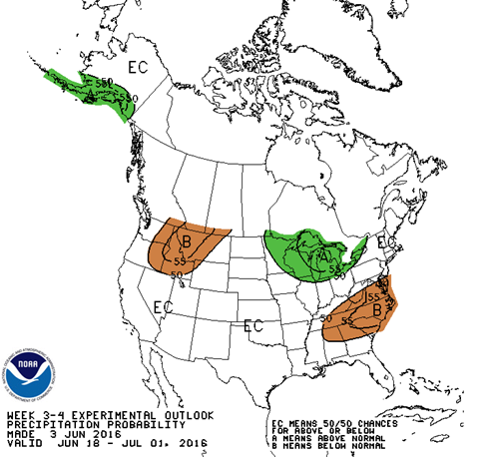
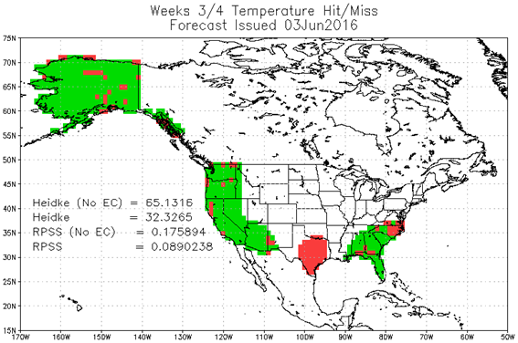
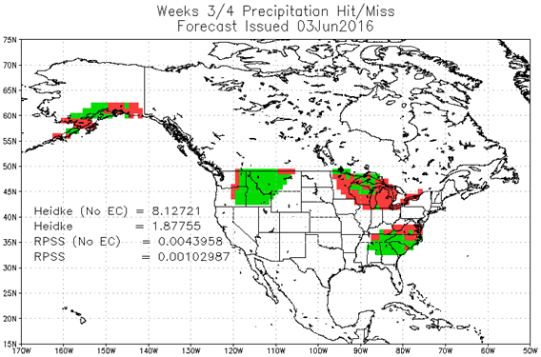
Experimental Weeks3-4 Temperature and Precipitation Outlooks
CPC started issuing Experimental combined Weeks 3-4 Temperature and Precipitation Outlooks on September 18, 2015.
Cross-branch activity within CPC with contributions from Scripps/GFDL, ESSIC, and ESRL PSD
Utilizes dynamical model output from CFS, ECMWF, and JMA
Utilizes statistical tools including:
MJO-ENSO Phase Model (CTB project.)
Coupled Linear-Inverse Model (C-LIM)
Constructed Analog
Issued once per week on Friday afternoon
Forecasts are 2-class (above/below) as opposed to traditional 3-class tercile probabilities
Users can provide feedback on product via web
Forecasts of opportunity depending on presence of large-scale climate drivers
Experimental forecasts are being evaluated for period of September 18, 2015 through September 17, 2016
Forecast Issued June 3 for June 18-July 1
Temperature
Precipitation
Verification

Slide 11
What’s Next in Mid-Range Forecasting?
Conduct research to identify additional sources of predictability
Model initialization: data sources and data assimilation
Physical processes
Ensemble system development
Enhance operational capability:
Extend ensemble to 30 days
Experimental weeks 3-4 outlooks
Engage partner agencies to enhance computing capacity enabling research, model development/calibration, R2O, and open collaboration
Engage stakeholder to support decisions
Notes:
Which area of requirements is most crucial depends on what happened recently or what is in the forecast

Slide 12
NOAA Contributions to Advance Forecast Informed Reservoir Operations (FIRO)
NOAA invests in science, monitoring, and forecast improvements that FIRO can use to optimize the availability of water resources without increasing flood risk.
NOAA (NWS, NMFS, and OAR) works with FIRO partners to maximize the use of NOAA products and services to balance flood and drought risks in the Russian River Basin.
NOAA participates in:
NOAA Habitat Blueprint
National Integrated Drought Information System
NOAA Hydrometeorology Testbed
National Water Center
NOAA is Developing:
Observations and monitoring to improve understanding of extreme precipitation behavior, impacts, prediction and flood risk.
Improved reliability and skill of extended weather forecasts for atmospheric rivers and for probability of extreme precipitation events.
Operational and experimental hydrometeorological modeling and probabilistic forecasts at the appropriate spatial and temporal scales to inform reservoir operations.
Notes:
Which area of requirements is most crucial depends on what happened recently or what is in the forecast

Slide 13
Summary
Sub-seasonal and seasonal forecasts would provide crucial information to national decision makers in multiple sectors
Current skill for subseasonal/seasonal predictions contingent on state of ENSO, MJO
Current positive skill begins slower for Weeks 3+4 temperature forecast – No skill for Weeks 3+4 precipitation forecast
Research needed to identify additional sources of predictability, improve model representation
Major efforts underway to enhance operations, research, and stakeholder engagement
Notes:
Which area of requirements is most crucial depends on what happened recently or what is in the forecast

