Slide 1
WATER RELATED INFRASTRUCTURE Programs & FUNDING IN KANSAS
CARA HENDRICKS, P.E.
KANSAS WATER OFFICE

Slide 2
KANSAS Water FUNDING FY18

Slide 3
Kansas water office
Established in 1981 as the water planning, policy, coordination and marketing agency for the state
Primary statutory function of the agency is the development and implementation of the State Water Plan for the management, conservation and development of the water resources of the state.
Water Planning & Implementation
Public Water Supply Programs
Kansas Water Authority
Consists of 13 voting members appointed by the Governor or Legislative leadership
Agency directors serve as ex-officio members
Statutorily within and a part of the Kansas Water Office.
Advises the Governor, Legislature and Director of the Kansas Water Office on water policy issues and for approving the State Water Plan.

Slide 4
STATE water plan
State Water Plan
Addresses current water resources issues and plans for future needs
Guides coordination of local, state and federal actions
Statutory authority and basic guidance for formulating the plan is contained in the State Water Resources Planning Act.
VOLUME I – Introduction & Background
VOLUME II – Statewide Water Assessment
VOLUME III – Water Plan Goals & Priorities
Developing and Maintaining State and Local Water Infrastructure

Slide 5
STATE WATER PLAN FUND
Created in 1989 (K.S.A. 82a-951)
Funds used for establishing and implementing water-related programs and projects identified in the State Water Plan.
Annual funding includes revenues from fees and demand transfers
Fees Total $12 – 13 million annually
Fee structure has remained virtually unchanged since the fund was established; Sand Royalties added in 1996, Clean Drinking Water Fee 2008
 |  | FY19 Est.
Municipal Water Fees | 3 cents/1,000 gallons | $3,200,000 | 25.6%
Clean Drinking Water Fees | 3 cents/1,000 gallons | $2,800,000 | 22.4%
Industrial Water Fees | 3 cents/1,000 gallons | $1,100,000 | 8.8%
Stockwater Use | 3 cents/1,000 gallons | $450,000 | 3.6%
Pesticide Fees | $100/Registration | $1,300,000 | 10.4%
Fertilizer Fees | $1.40/ton | $3,500,000 | 28.0%
Pollution Fines/Penalties | Est. $150,000 | $150,000 | 1.2%
Sand Royalties | $0.15/ton | $16,000 | 0.1%
 | Total | $12,516,000

Slide 6
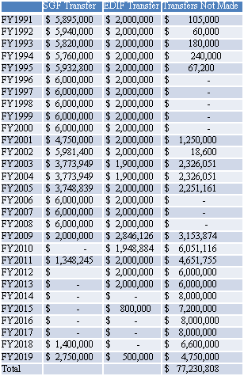
STATE WATER PLAN FUND
(2) Demand transfers from state funds
*Economic Development Initiatives Fund
(EDIF) - $2 million (statutory)
*State General Fund (SGF) - $6,000,000
(statutory)
*Last time full statutory transfers made
FY2008*
FY19 $500,000 EDIF
FY19 $2.75 million SGF

Slide 7
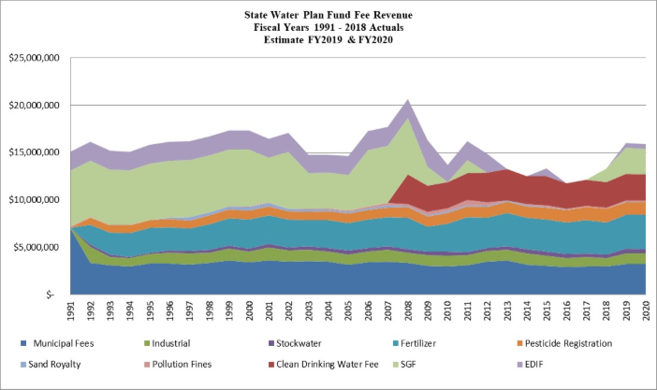
STATE WATER PLAN FUND HISTORY

Slide 8
‘VISION’ OF THE FUTURE OF WATER IN KANSAS
“Kansans act on a shared commitment to have the water resources necessary to support the state’s social, economic and natural resource needs for current and future generations.”
2013 - Governor call to action to develop 50-year Water Plan
Public outreach, 14 RACs developed, statewide Vision completed
With no change in 50 years
The Ogallala Aquifer would be 70 percent depleted
Our reservoir storage would be 40 percent filled with sediment

Slide 9
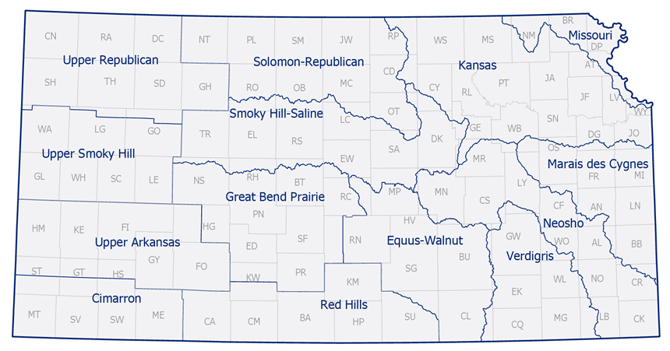
REGIONAL ADVISORY COMMITTEES
RACs developed regional action plans for public input

Slide 10
Funding the ‘VISION’
Blue Ribbon Funding Task Force (BRFTF)
Created through ‘Vision’ process
Address funding needs for ‘Vision’ implementation
Comprised of KWA members, Legislators, other stakeholders
Funding Proposal
$55 million in annual funding needs for full implementation
Two revenue options proposed:
Restoration of $8 million statutory demand transfers from SGF/EDIF
1/10 of 1% state sales tax dedicated to SWPF

Slide 11
WATER PLAN/’VISION’ projects
SWPF-funded programs supporting infrastructure:
Nonpoint Source Pollution Assistance (KDA)
Watershed Dam Construction (KDA)
Water Supply Restoration Program (KDA)
Streambank Stabilization (KDA/KWO/KDHE)
MOU – Storage O&M (KWO)
Technical Assistance to Water Users (KWO)
Water Technology Farms (KWO-A&E)
Watershed Conservation Practice Implementation
Milford Lake Watershed RCPP
John Redmond Reservoir Dredging (KWO)

Slide 12
KWO Public water supply program funds
State owns storage in 14 federal reservoirs within the state
In 2017, KWO developed the PWS Comprehensive Capital Development Plan
Accounts for all revenue and expenses related to the State’s public water supply storage
Provides for long-term planning of future program needs, including
Acquisition of all the water supply storage under federal contracts
Potential new storage development
Protection and restoration of the storage owned by the State
Portion of John Redmond Reservoir Dredging project paid for through KWO’s PWS program (CCDP)
Marking program has also provided Streambank Stabilization projects

Slide 13
STATE REVOLVING FUND & KIAC
DWSRF & KWPCRF
Administered by KDHE Division of Environment, Bureau of Water
Provides financial assistance to KS municipalities in the form of loans for construction of publicly owned wastewater treatment facilities and public water supply system infrastructure
Kansas Interagency Advisory Committee (KIAC)
Review committee for CDBG funding of water/wastewater projects
KDHE, Dept. of Commerce, USDA Rural Development, KWO
Meetings with applicants
Rank projects by priority
Regional solutions for PWS needs
Interconnections for more efficient drinking water supply and treatment

Slide 14
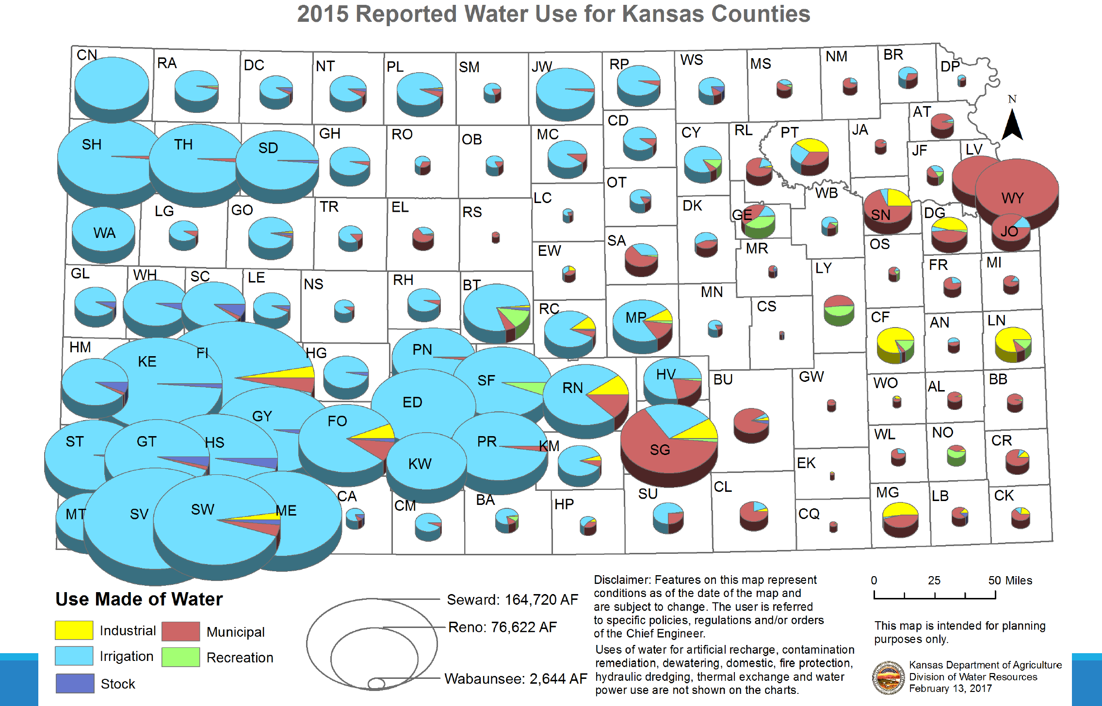
Kansas water funding challenges
State interests in water can be divisive

Slide 15
ONGOING EFFORTS for WATER FUNDING IN KANSAS
Continue to look for leveraging opportunities for federal funds from various agencies/programs (USACE, USGS, NRCS, BOR, EPA)
Regular engagement/communication with RACs, KWA, other stakeholders
Educate legislators on water issues
Report on program/project results
Annual Governor’s Conference on the Future of Water in Kansas

Slide 16
Questions?
CARA HENDRICKS, P.E.
KANSAS WATER OFFICE

