Slide 1
Incorporating Water into Electricity Planning
WSWC-WGA Water/Energy Workshop
April 2, 2013
Doug Larson
Executive Director
Western Interstate Energy Board

Slide 2
Outline
Western Interconnection electrical context
Value of water info for --
  Electric transmission planners and policy makers
  Utility resource plan developers and reviewers
  Generation developers

Slide 3
Western Interconnection context
Load growth
Generation resources
Generation retirements and additions
Technology trends
Drivers

Slide 4
Load growth – low and could be lower
Compound Annual Growth Rates (Annual Energy, 2010-2032)
Source: Lawrence-Berkeley National Laboratory work for SPSC

Slide 5
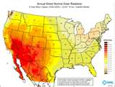
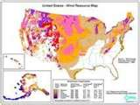

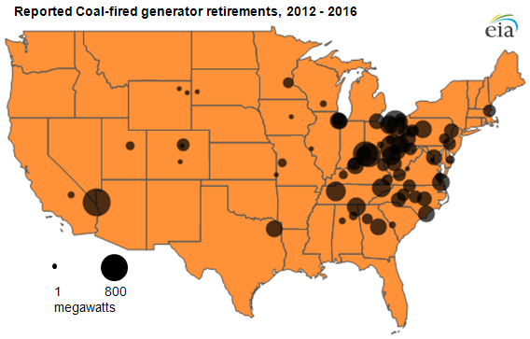
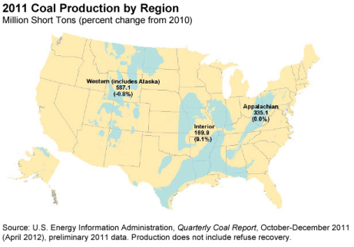
Generating resources – Renewables, coal
Renewable Resources
Solar
Geothermal
Wind
Coal demand and resources
Coal plant retirements

Slide 6
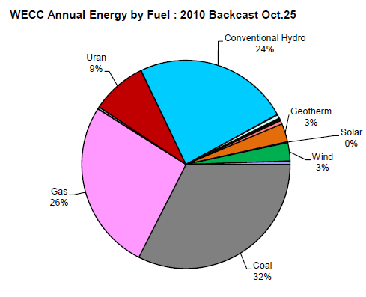
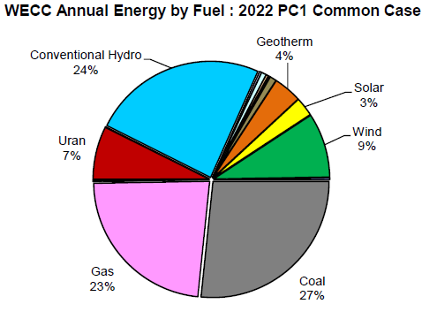
Generating resources – natural gas
227,386 GWh
234,683 GWh
Source: Western Electricity Coordinating Council

Slide 7
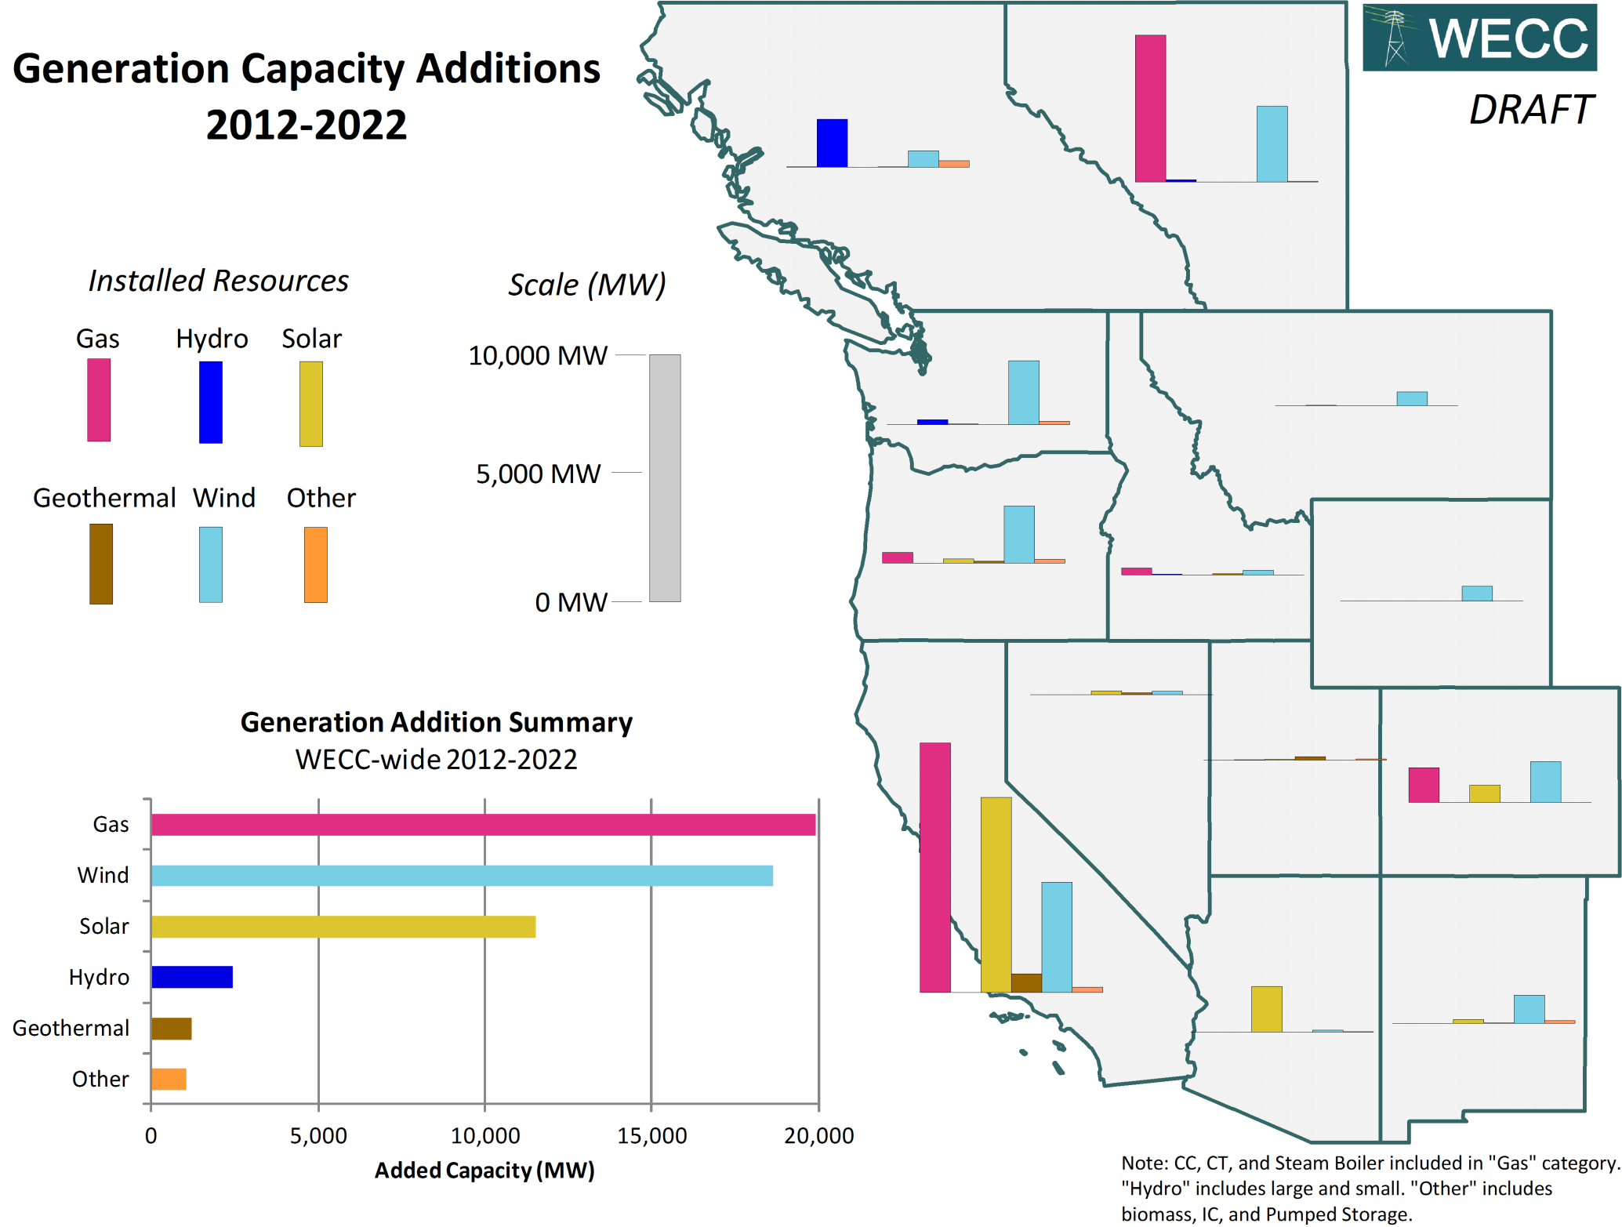
Source: Western Electricity Coordinating Council

Slide 8
Factors driving generation procurement decisions
Cost
State policies
  Renewable Portfolio Standards
  Greenhouse gas emissions
Resource flexibility

Slide 9
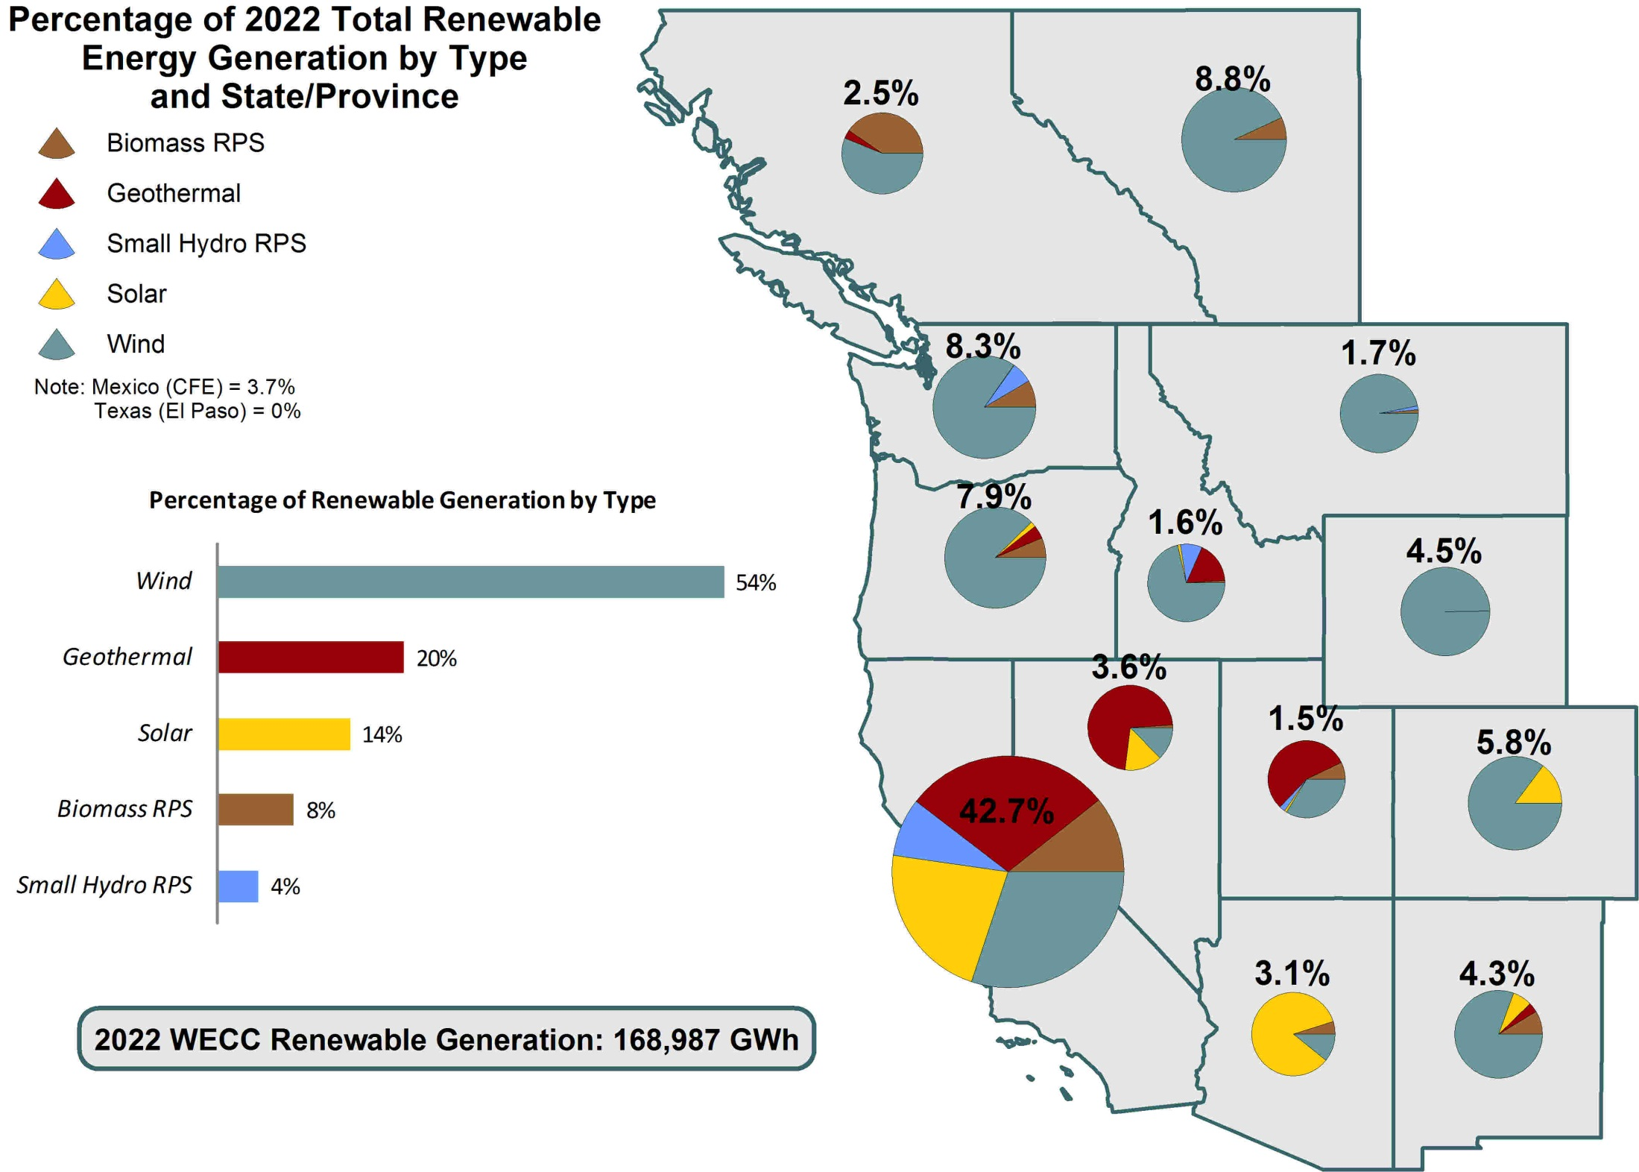
Source: Western Electricity Coordinating Council

Slide 10
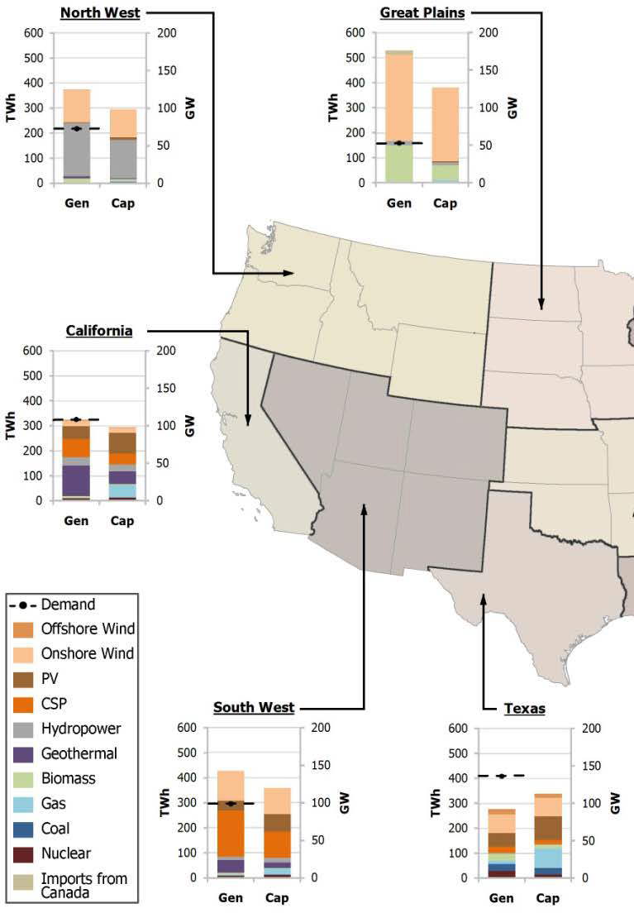
80% Renewables in 2050
Concentrating solar power
Geothermal
Source: NREL Electricity Futures Study

Slide 11
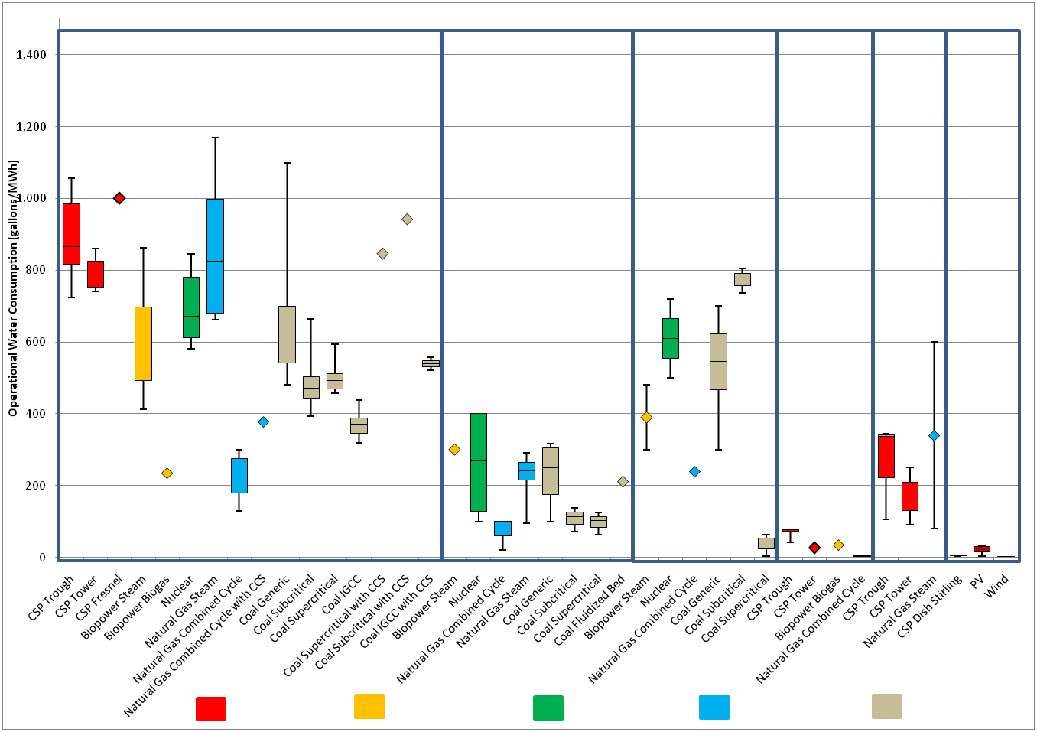
Operational water consumption factors for electricity generating technologies
Caption or heading (if you have one)
Recirculating Cooling
Once-through Cooling
Pond Cooling
Dry Cooling
Hybrid Cooling
No Cooling Required
(insert really cool image/supergraphic from your work)
Operational water consumption (Gal/MWh)
CSP and PV
Biopower
Nuclear
Natural Gas
Coal
Source: Macknick et al. 2011

Slide 12
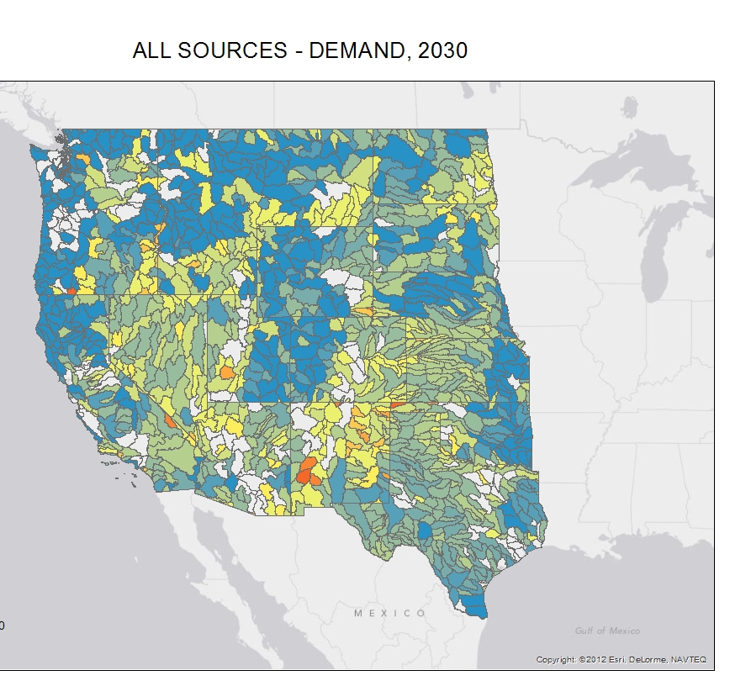
Geothermal
Concentrating Solar Power

Slide 13
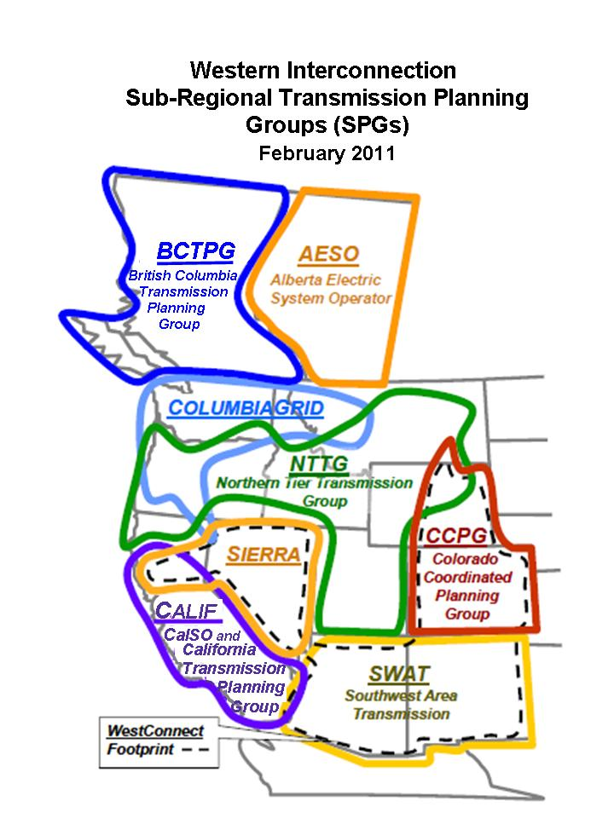
Users of water information:
Electric transmission planners
Policy makers
1. Transmission planners
  WECC planning
  Regional planning groups
2. Utility integrated resource plans
  Utility resource planners
  PUC reviewers of utility resource plans

Slide 14
Users (cont’d)
4. Generation and transmission developers
  Screening tool for where regulators and policy makers may have concerns
5. Policy makers
  State energy policy offices and PUCs
  Federal land management agencies

