Slide 1
NOAA/WSWC Meeting on advancing a Seasonal Precipitation Forecast Improvement Project
Name: Andy Hoell
Organization: NOAA/ESRL/PSD

Slide 2
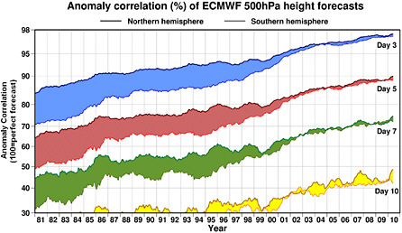
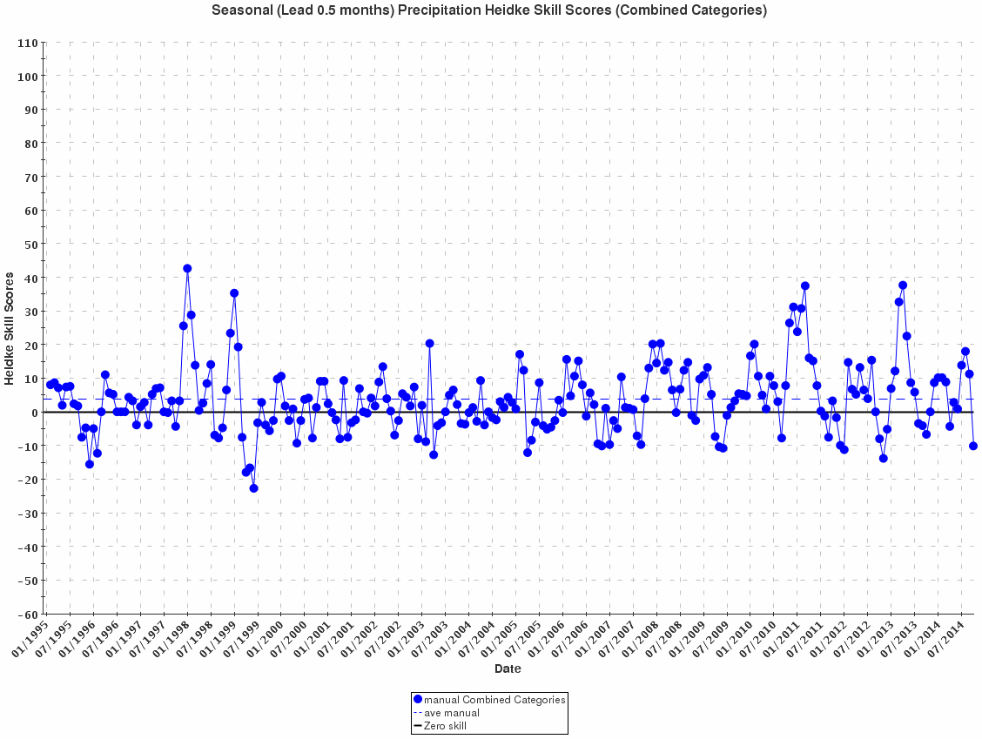
1. What are the knowledge gaps to advance seasonal forecast skill for western watersheds?
Identify conditional skill to not just provide a forecast, but a forecast of the skill:
a. Better utilize the state of ENSO
b. Utilize the antecedent conditions
Weather forecast skill has progressively increased
Seasonal forecast skill has not increased
Half Month Lead Seasonal Precipitation Heidke Skill Score
EmpiricalCCA
Atmospheric
Models
Coupled
Models
Many Coupled
Source: National Research Council
Source: CPC

Slide 3
2. What are the priority research questions that need to be answered to advance seasonal forecast skill for western watersheds?
ENSO is a key driver. Is it the only one?
“Nearly all of the AGCM skill in U.S. precipitation and surface air temperature, arising from global SST influences, can be explained by a single degree of freedom in the tropical SST field—that associated with the linear atmospheric signal of El Niño–Southern Oscillation (ENSO). The results support previous findings regarding the preeminence of ENSO as a U.S. skill source.”
Diagnosing Sources of U.S. Seasonal Forecast Skill (2006), J. Climate
For N. CA Strongest El Niño events drive a shift to wet conditions whereas moderate events do not

Slide 4
3. What are the strengths and weaknesses of the white paper as currently presented?
“Accurate seasonal prediction of precipitation over the United States is an extremely difficult problem. Improving these predictions will require a substantial and sustained commitment of resources focusing on gaps in the end to end chain from increased understanding of sources of predictability through operational implementation of new and improved tools.”
Powerful statements that can be explored further
Are forecasters not sufficiently knowledgeable? No, they are.
Do we have accurate tools to make seasonal forecasts? No, we don’t.
Different models exhibit different accuracy and precision, as do the practices that we use to optimally combine the various tools
Do we have accurate data from which to begin models? No, we don’t.
Example: Monitoring ENSO by infrastructure like TOGA/TAO

