Slide 1
Colorado River Basin:
Overview of Determining Lake Powell and Lake Mead Annual Operational Tiers
WSWC Seasonal Precipitation Forecast Workshop
December 15, 2015

Slide 2
Presentation Overview
Operational Decision-Making Hierarchy
24-Month Study and the Annual Operating Plan
Implementing the 2007 Interim Guidelines
Projected Operations in 2016
Mid-term Operations Model (MTOM)
Questions / Discussion
2

Slide 3
Operational Decision-making Hierarchy
Spatial Resolution Time Horizon
Operational Activity
Decisions
Basin-wide
over decades
Long-term Planning
Operating Criteria and Guidelines
Basin-wide
over 1-5 years
Mid-term Operations and Planning
Annual Operating Plan and Mid-term Planning
Sub-basin
over 4-6 weeks
Short-term Scheduling
Water and Power Schedules
Single project
over 1-7 days
Real-time Control
Unit Commitment Economic Dispatch Automatic Generation and Control

Slide 4
Overview of Annual Operating Plan
AOP authorized under the Colorado River Basin Project Act of 1968
Section 602(b) of the CRBPA requires the Secretary to prepare and “transmit to the Congress and to the Governors of the Colorado River Basin States a report describing the actual operation under the adopted criteria [i.e., the Operating Criteria] for the preceding compact water year and the projected operation for the current year”

Slide 5
Overview of Annual Operating Plan
A report on the current year’s operations and the upcoming year’s projected operations
Usually published by the end of December of the current calendar year
Three consultations are held each year
May, July, and September of the current year
2015 AOP available at:
http://www.usbr.gov/lc/region/g4000/aop/AOP15.pdf
Draft 2016 AOP available at:
http://www.usbr.gov/lc/region/g4000/AOP2016/AOP16_draft.pdf

Slide 6
Operational Decision-making Hierarchy
Spatial Resolution Time Horizon
Operational Activity
Decisions
Basin-wide
over decades
Long-term Planning
Operating Criteria and Guidelines
Basin-wide
over 1-5 years
Mid-term Operations and Planning
Annual Operating Plan and Mid-term Planning
Short-term Scheduling
Water and Power Schedules
Single project
over 1-7 days
Real-time Control
Unit Commitment Economic Dispatch Automatic Generation and Control
RiverWare Operations Model
Colorado River Simulation System (CRSS)
Daily Operations Models
Hourly Operations Models
Sub-basin
over 4-6 weeks
24-Month Study Model
Mid-term Operations Probabilistic Model (MTOM)

Slide 7
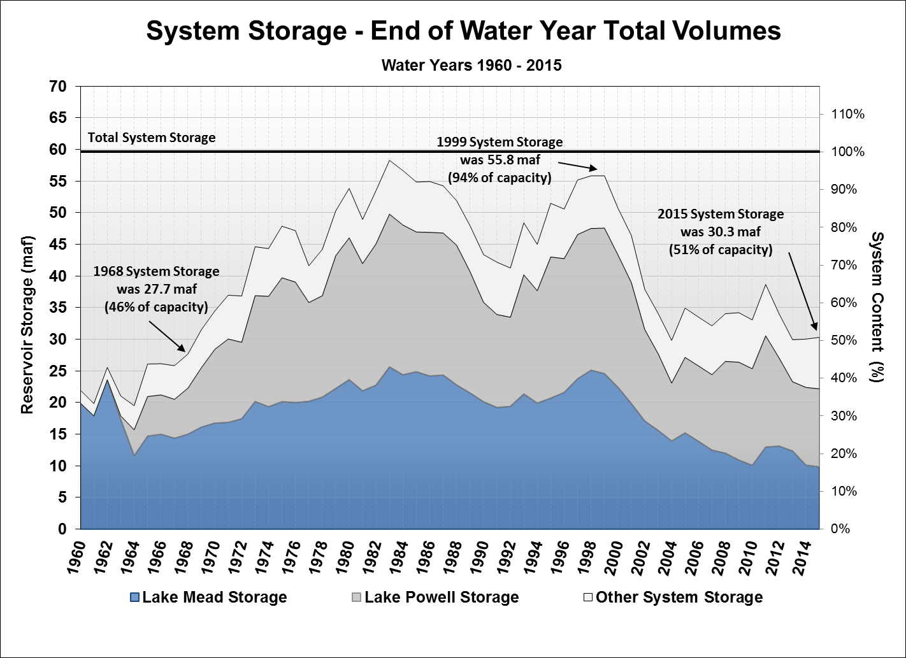
7
Notes:
Key Points:
The last 15 years have been the driest in over 100 years of record-keeping.
Before the drought begin in 2000, the system water nearly completely full at 94% of capacity.
The system went from full to about half-full in the first 5 years of the drought (2000-2004).
The system remained at about half-full from 2005-2011 (three years had above average inflow during this period.
The drought has persisted, however, with 3 of the past 4 years will below average.
Based on current projections, total system storage will be 46% of capacity at the end of water year 2015.
The last time total system storage was this low was in 1968 during the filling of Lake Powell.

Slide 8
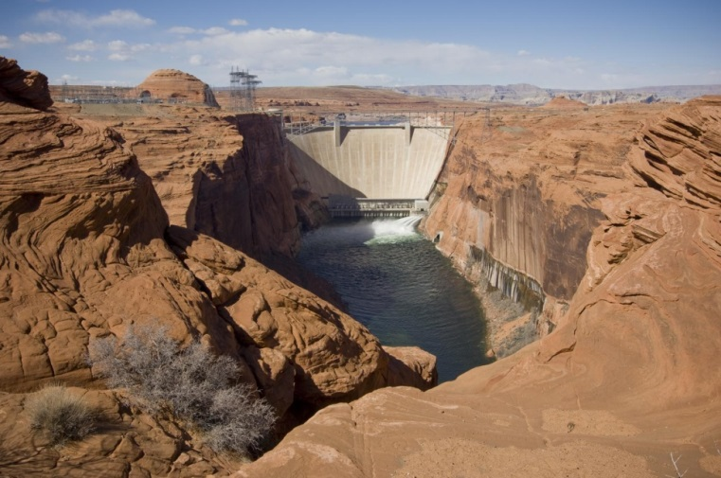
2007 Interim Guidelines
In place for an interim period (2007 – 2026)
Provide for coordinated operations of Lake Powell and Lake Mead to minimize Lower Basin shortages and Upper Basin curtailments
Through water year 2015, equalization releases total 6.28 maf and balancing releases total 770 kaf
Encourage efficient use and management of Colorado River water through the ICS mechanism
Through calendar year 2014, the total ICS balance is 840 kaf, of which 240 kaf are Extraordinary Conservation ICS
Establish guidelines for determining shortages in the Lower Basin
8
Notes:
8

Slide 9
24-Month Study in Setting Operational Tiers
Projections from the 24-Month Study are used to set annual operating tiers for Lake Powell and Lake Mead
Timing of Operational Decisions
August 24-Month Study projections of January 1 elevations sets the operating tiers for Lake Powell and Lake Mead
When Lake Powell is in Upper Elevation Balancing Tier, April 24-Month Study projections of September 30 elevations may result in an adjustment to Lake Powell’s operations
This information is reported in the Annual Operating Plan
9

Slide 10
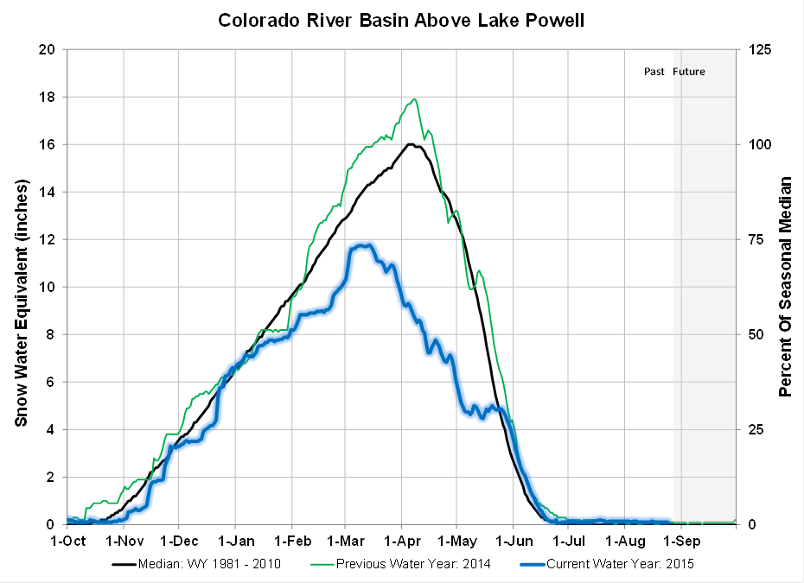
Colorado River Basin Snowpack and Runoff
Water Year 2015
2015 April-July Inflow
into Lake Powell
Date Issued | % of Average | Million Acre-Feet
Jan 1 | 91 | 6.50
April 1 | 52 | 3.75
May 1 | 42 | 3.00
June 1 | 70 | 5.00
July 1 | 88 | 6.29
Aug 1 (observed) | 94 | 6.71

Slide 11
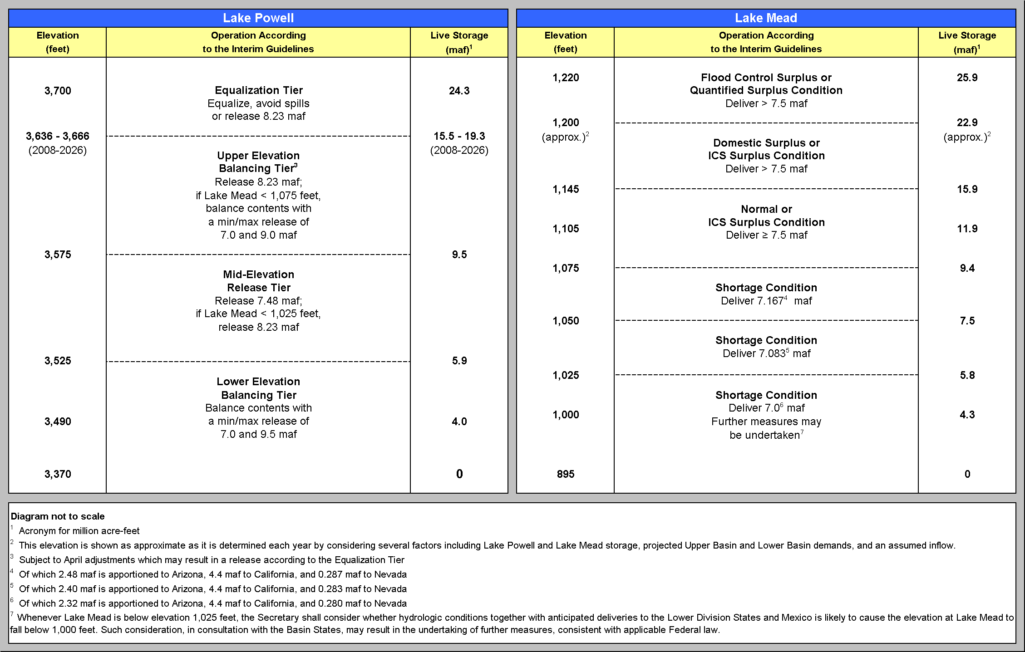
Lake Powell & Lake Mead Operational Table Operational Tiers for Water/Calendar Year 2016 determined with the August 2015 24-Month Study
3,602.46 ft
Jan 1, 2016 projection
1,082.33 ft
Jan 1, 2016 projection
Notes:
Interim Guidelines Operational Diagrams
Key Points:
Two diagrams: Powell on the left, Mead on the right
Provides an objective and prescriptive coordinated operation for the two reservoirs throughout the full range of reservoir operations
Put in place in December of 2007, envisioned to be in place through 2026
After click, red lines appear.
Key Points:
In 2011, Lake Powell will operate in the Upper Elevation Balancing Tier, releasing a minimum of 8.23 maf and ranging to a maximum that could exceed 13 maf, depending on the April 1 inflow forecast
In 2012, Lake Mead will operate in the ICS Surplus tier, resulting in deliveries of 7.5 maf (plus or minus delivery or creation of ICS surplus) to Arizona, California, and Nevada.

Slide 12
End of CY 2015 Projection:
3,600.9 feet
End of CY 2016 Projection:
3,594.9 feet
(Range 3,575 to 3,368 feet)

Slide 13
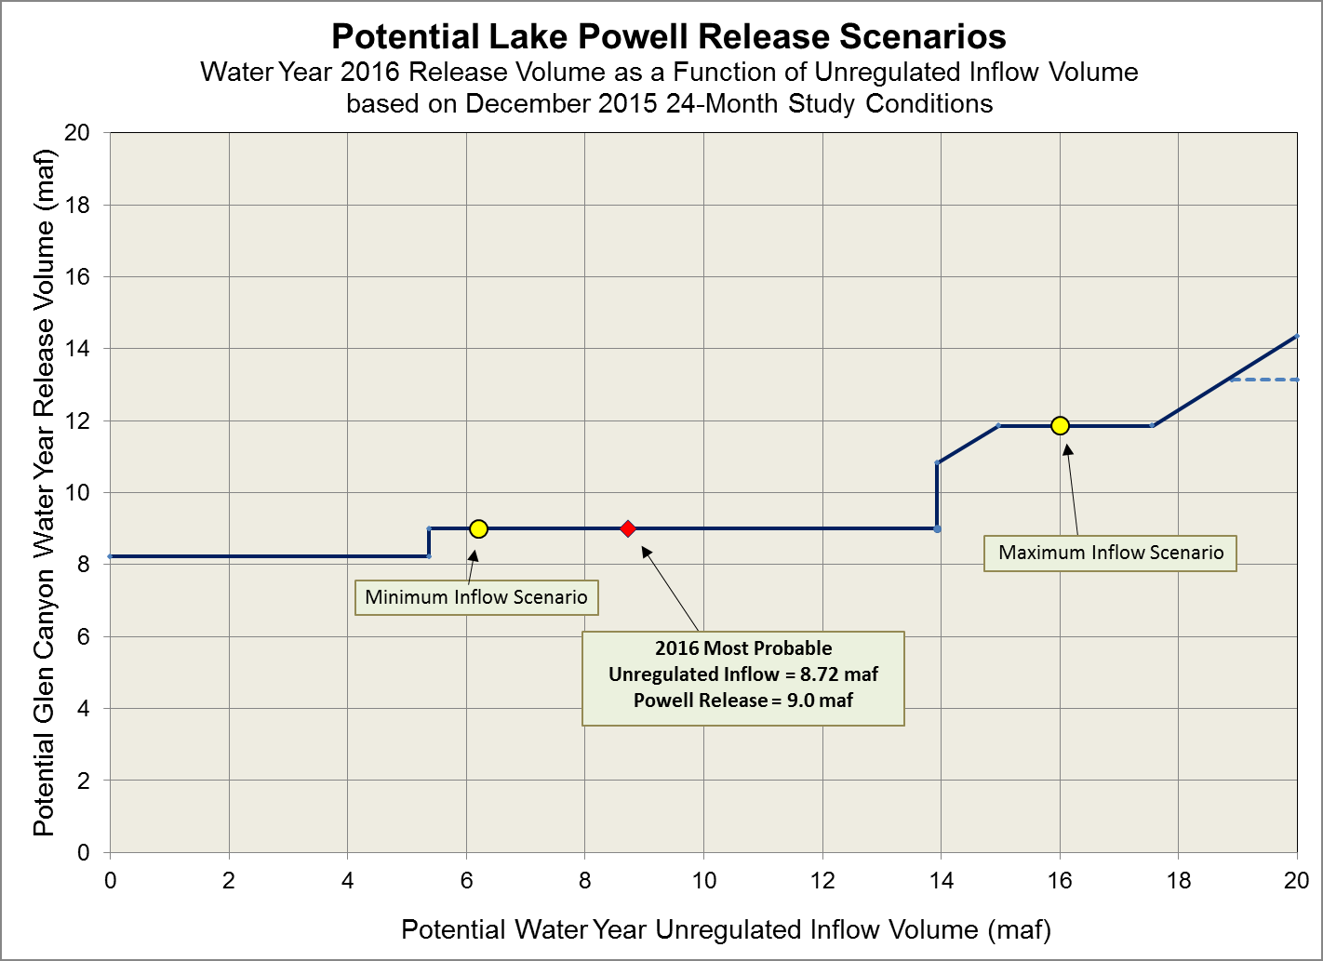
Water Year 2016
Upper Elevation Balancing Tier
Initial release of 8.23 maf
Potential April adjustment to Equalization or Balancing
April adjustment to
Equalization releases
April adjustment to
Balancing releases
No April adjustment

Slide 14
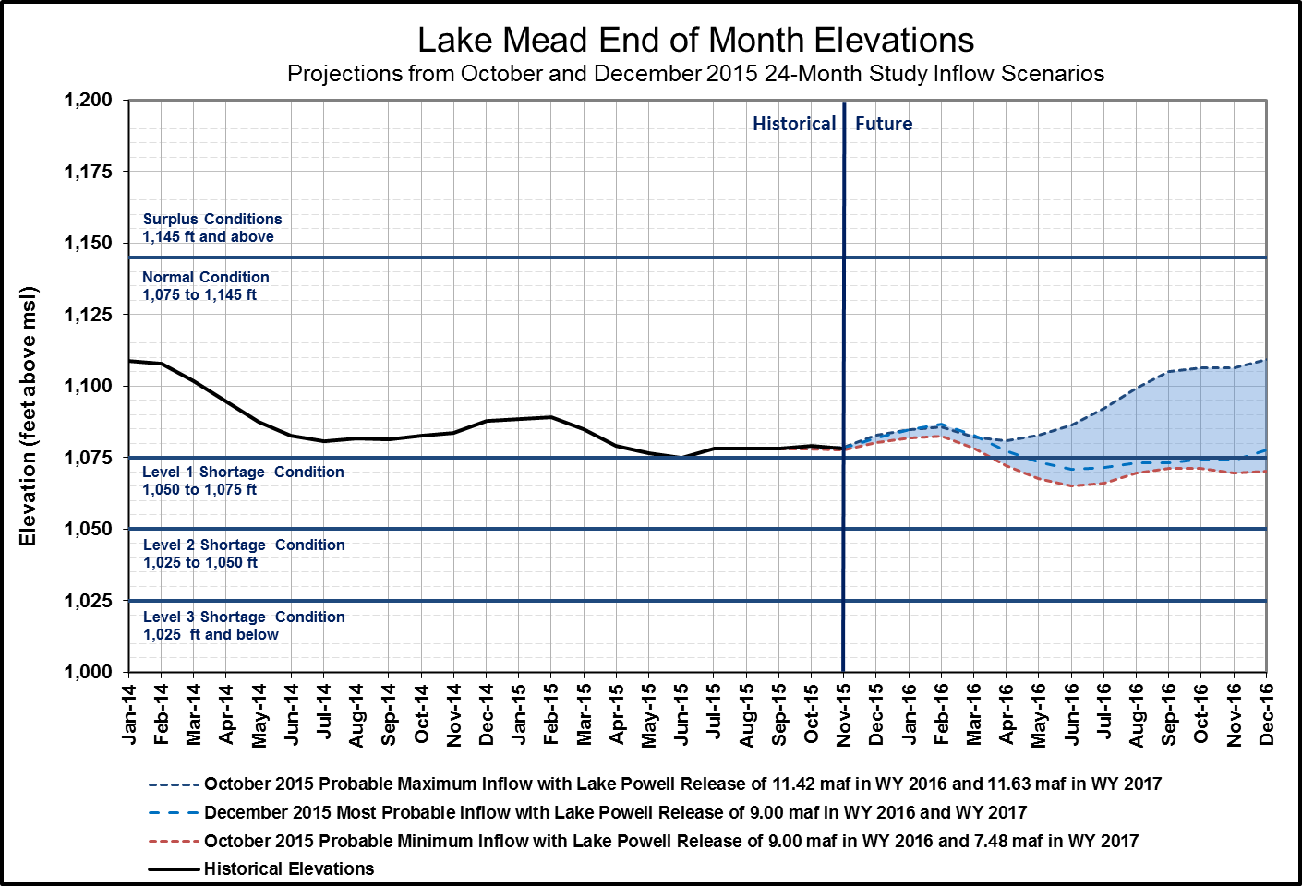
End of CY 2015 Projection:
1,082.0 feet
End of CY 2016 Projection:
1,077.5 feet
(Range 1,070 to 1,109 feet)

Slide 15
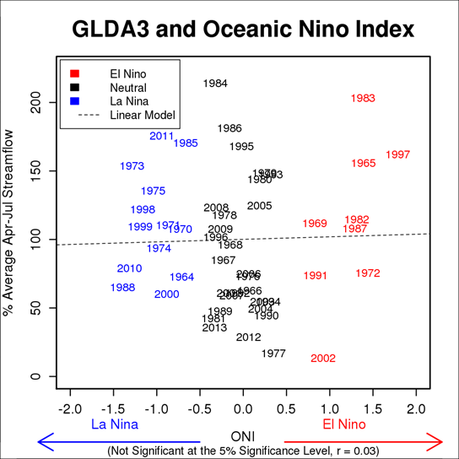
Comparison of Lake Powell inflow
and ENSO events since 1964
Percent of Average April-July Streamflow
Source: CBRFC website.
15

Slide 16
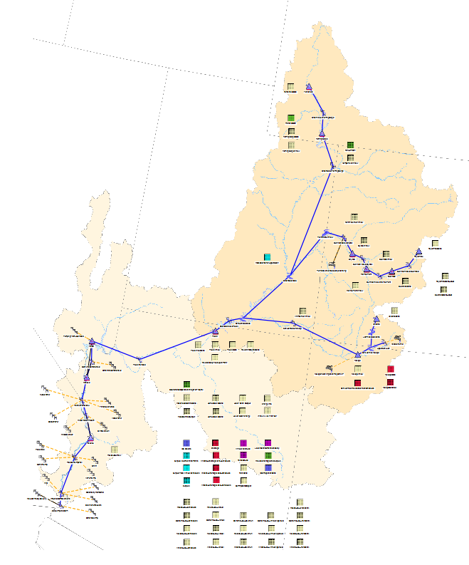
Mid-Term Operations Model (MTOM)
An additional tool to evaluate risk and uncertainty in Colorado River Basin
Based on the 24-Month Study model
Utilizes an ensemble inflow forecast provided by the CBRFC to simulate a multi-trace output
24-Month Study remains the official model for operational tier determinations
16

Slide 17
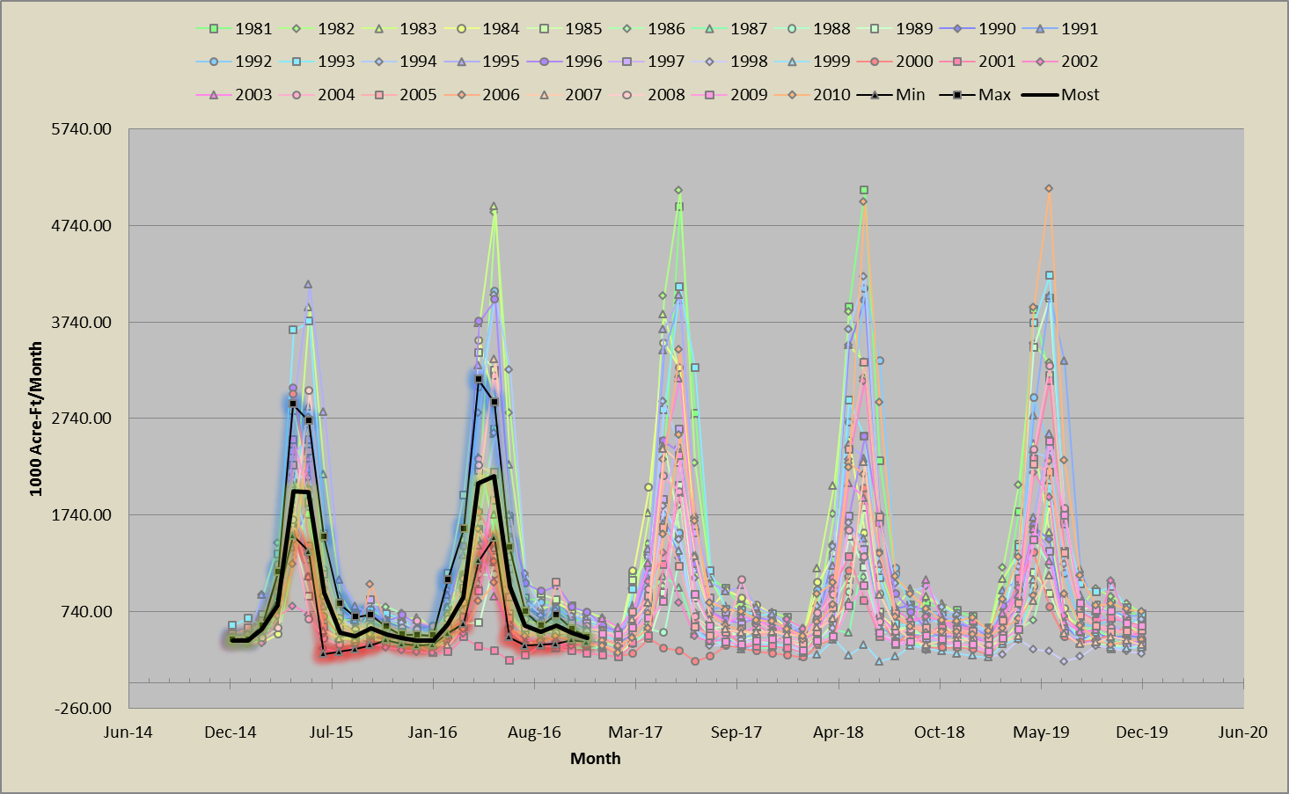
CBRFC Inflow Forecasts: Ensemble vs Discrete
--
--
--
January 2015 MTOM: Lake Powell Inflows
17

Slide 18
Colorado River Basin:
Overview of Determining Lake Powell and Lake Mead Annual Operational Tiers
For further information:
http://www.usbr.gov/uc/
http://www.usbr.gov/lc/
Notes:
18

