Slide 1
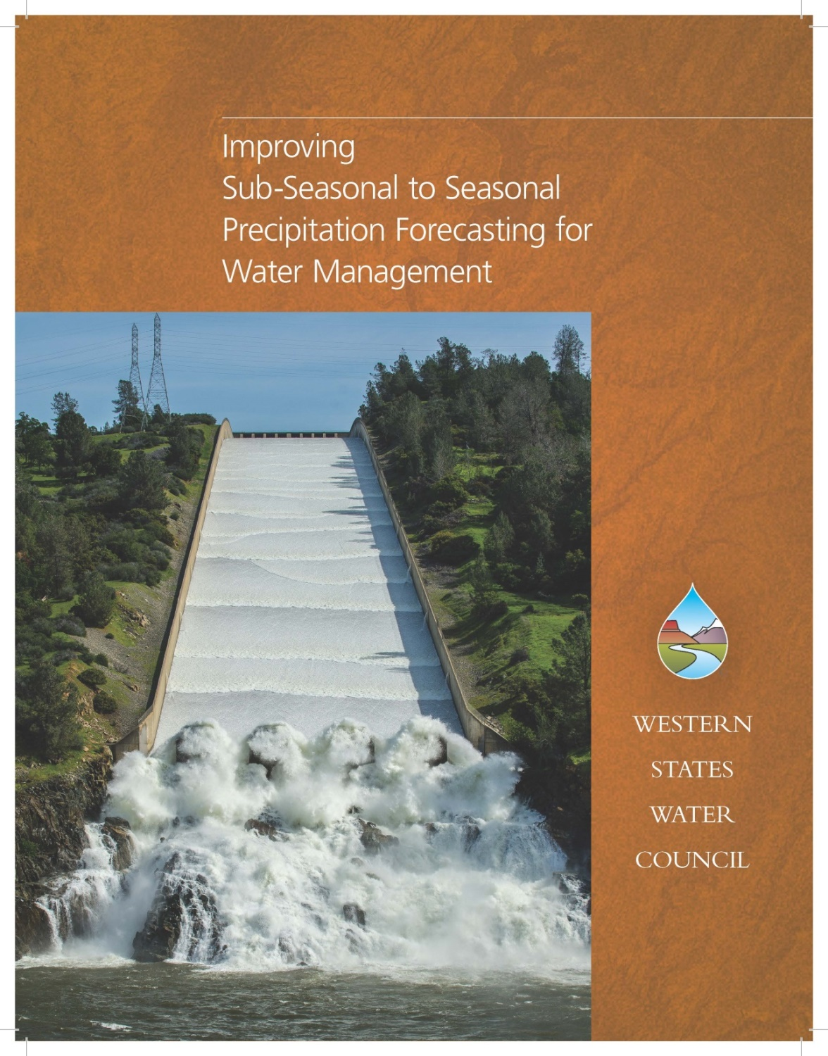
Jeanine Jones, Western States Water Council

Slide 2
Why This Effort? Western States Water Council Perspective
Importance of skillful sub-seasonal to seasonal precipitation forecasting for Western water management
Lack of resources being directed to improving S2S precipitation forecasting
Lack of resources being directed to Western precipitation forecasting needs
Time is ripe for action

Slide 3
Variability of Western Precipitation
Slide courtesy of Mike Dettinger, USGS/University of California San Diego, Scripps
Std Dev of Annual Precipitation
Mean Annual Precipitation
Dettinger et al, 2011

Slide 4
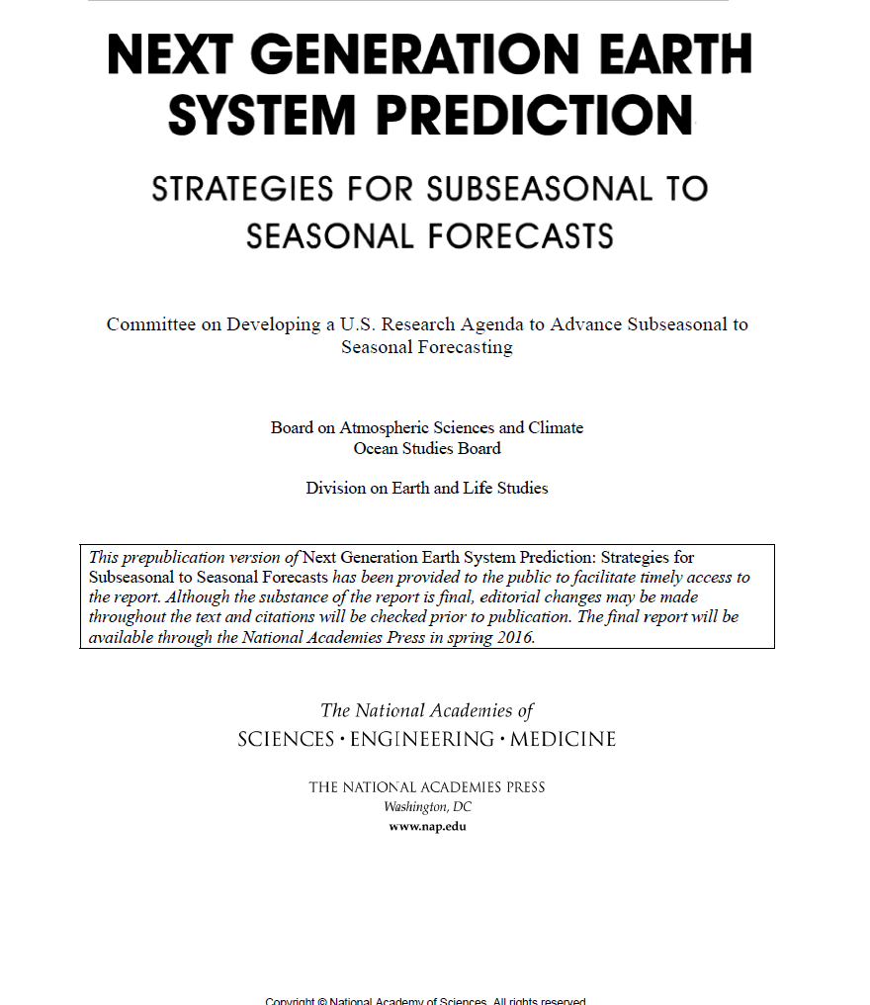

Slide 5
Importance of Improved Forecasting for Water Management

Slide 6
Lead Time Very Important for Water Management
Public health & safety decisions
Balancing risk/cost trade-offs
Increasing water management efficiency
Operating within legal & regulatory frameworks
Reducing impacts of extreme events
Responding to increased competition for resources

Slide 7
Will the Rest of This Winter be Wet or Dry? Example Sub-Seasonal Decisions
How much water will we be able to provide to our water users? When can we make the announcement?
Will we hit hydrologic shortage triggers that require extraordinary conservation measures, or the need to negotiate contracts or adopt regulations?
Is an elevated flood risk likely this spring? Should we pre-position resources?
If the rest of this winter looks dry, can we use reservoir flood control space to store water for allocation to users (e.g., forecast-informed reservoir operations)?
Will we have to curtail diversions on intensively used rivers? How early in the season?

Slide 8
Will This Winter be Wet or Dry? Example Seasonal Decisions
Should we begin negotiating contracts for one-time sale of surplus wet-weather water? Can we set up a temporary groundwater banking program to take advantage of wet conditions?
Do we need to seek additional drought response funding or raise water rates? Do we need to budget for enhanced water conservation activities?
Should we make plans and adopt regulations for adopting a drought water bank?
Should we intensify flood preparedness activities in vulnerable areas?

Slide 9
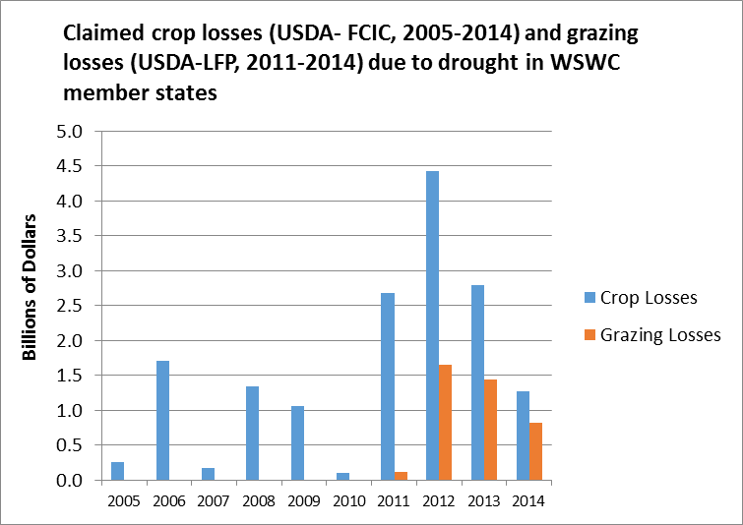

Slide 10
New understandings of role of extreme precipitation (e.g., atmospheric river storms) in West, implications for improving predictability at regional scale

Slide 11
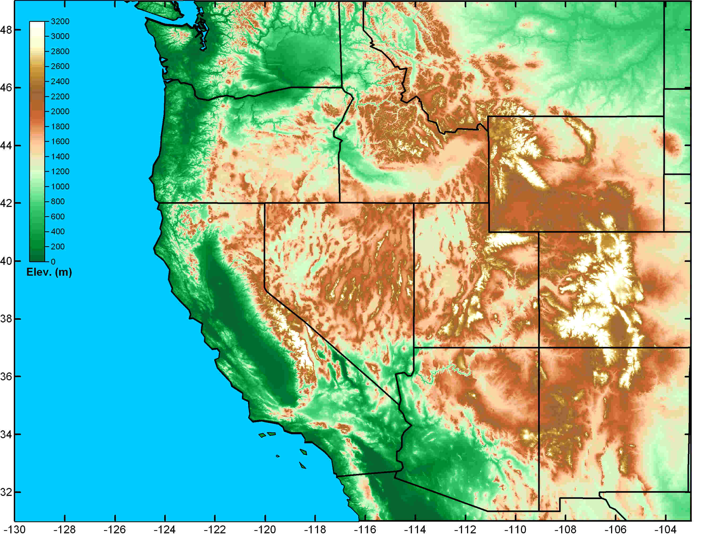
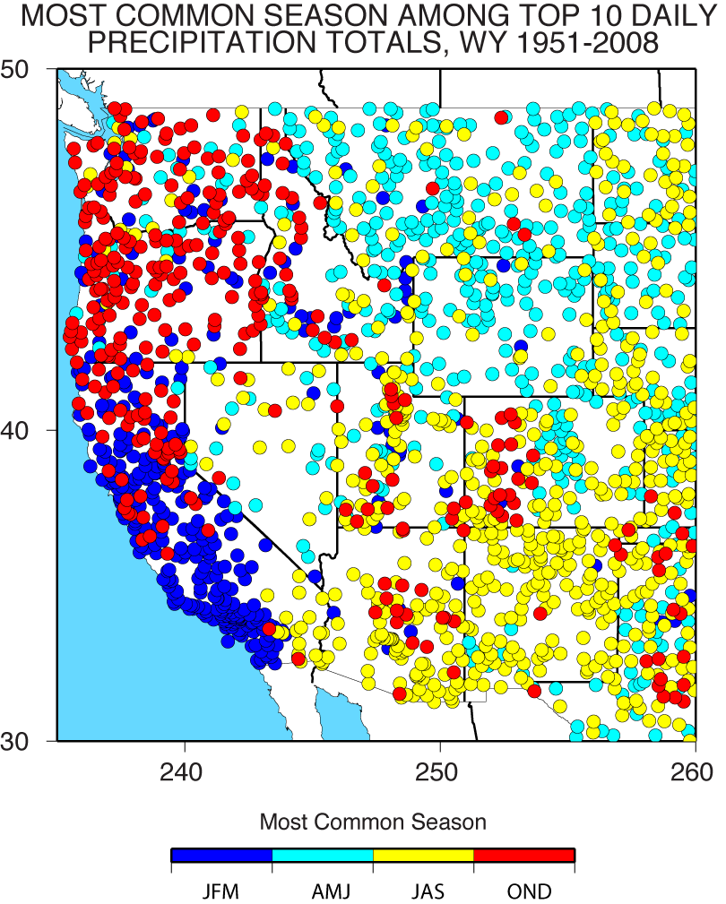
Schematic illustration of regional variations in the primary weather phenomena that lead to extreme precipitation, flooding and contribute to water supply in the Western U.S.
Great Plains Deep Convection
(spring and summer)
Atmospheric Rivers
(fall and winter)
Spring Front Range Upslope (rain/snow)
Southwest Monsoon (summer & fall)
Marty Ralph et al

Slide 12
California State Agency Investments in Observing & Researching AR Storms
State share of NOAA Hydrometeorology Testbed program (HMT) in California -- $15M
CalWater field observing campaigns building on the HMT project -- $5M
Advanced precipitation monitoring & forecasting state grant to Bay Area local agencies -- $19M
Research with Scripps/UC San Diego -- $3.5M

Slide 13
Summary
High need for improved S2S precip forecasting for water management
Scientifically challenging, but large potential payoff for water, agriculture, transportation, etc. sectors
Recent National Academy of Sciences report, new regional-scale observations of extreme precipitation show pathway forward

