Slide 1


Montana
Infrastructure Financing Strategies
A Miller
March 2019

Slide 2
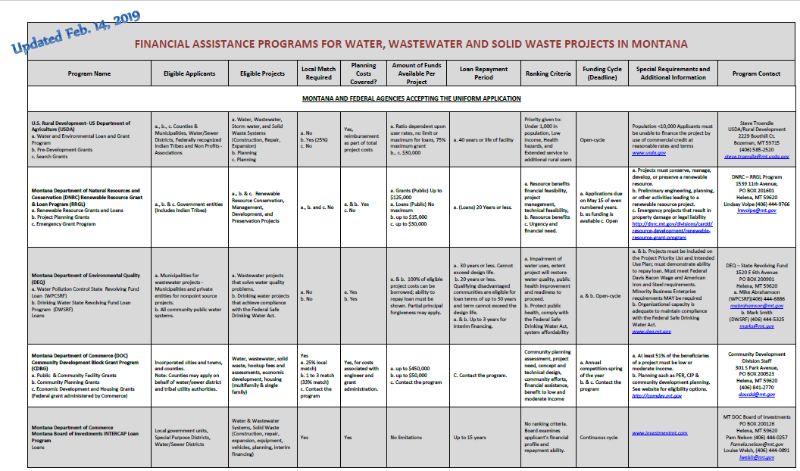

Slide 5
Wastewater Projects FY 2018
PROJECT SPONSOR | COMM POP | PROJECT NAME | COUNTY | TOTAL PROJECT COST | RRGL STATE GRANT | TSEP STATE GRANT | SRF FORGIVEN | LOAN REGULAR SRF | LOAN REGULAR SRF C LOANS | RURAL DEV GRANT | RURAL DEV LOAN | FEDERAL ARMY CORP WRDA | COMMUNITY FUNDS LOCAL | COAL TAX LOAN WDL | COAL BOARD | CDBG GRANT
Big Timber, City of | 1641 | WWTP Rehabilitation | Sweet Grass | $3,684,800 |  |  |  | $3,486,000 |  |  |  |  | $198,800
Colstrip, City of | 2214 | WWTP Rehabilitation | Rosebud | $2,421,000 |  |  | $107,000 | $987,000 |  |  |  |  | $827,000 |  | $500,000
Cut Bank, City of | 2869 | Wastewater Project | Glacier | $16,545,000 | $125,000 | $625,000 | $400,000 | $3,000,000 |  | $1,472,000 | $9,998,000 |  | $925,000
Dawson Co-W Glendive | 4935 | Wasewater Imp | Dawson | $3,931,000 | $100,000 | $750,000 | $400,000 | $2,681,000
Great Falls Storm Drain | 58505 | WW Storm Drain | Cascade | $3,270,000 |  |  |  | $3,270,000
Livingston | 7044 | WWTP | Park | $19,505,000 | $125,000 | $625,000 | $400,000 | $6,500,000 | $4,840,000 | $1,715,000 | $5,000,000 |  | $300,000
Livingston BAN | 7044 | WWTP-Rehab | Park | $5,000,000 |  |  |  | $5,000,000
Plentywood | 1734 | Sewer lines | Sheridan | $2,690,444 |  |  | $400,000 | $2,237,000 |  |  |  |  | $53,444
RDB 19 |  | Various | Various | $1,000,000 |  |  |  | $1,000,000
Red Lodge A & B | 2125 | WW Improvements | Carbon | $1,449,500 |  |  | $314,500 | $989,000 |  |  |  |  | $146,000
Shelby A & B | 3376 | Storm Sewer | Toole | $648,000 |  |  | $300,000 | $348,000
Terry, Town of | 605 | WW Project I&I | Prairie | $905,000 | $81,000 |  | $164,000 | $660,000
Vaughn WSD | 658 | Engineering/Land | Cascade | $52,000 |  |  |  | $52,000
Vaughn WSD | 658 | Sewer lines | Cascade | $2,905,000 | $10,000 | $750,000 | $400,000 | $1,745,000
 |  |  | Totals | $64,006,744 | $441,000 | $2,750,000 | $2,885,500 | $31,955,000 | $4,840,000 | $3,187,000 | $14,998,000 | $0 | $2,450,244 | $0 | $500,000 | $0
 |  |  |  |  |  |  | SRF TOTAL | $34,840,500
 |  |  |  | $64,006,744

